Slide 1
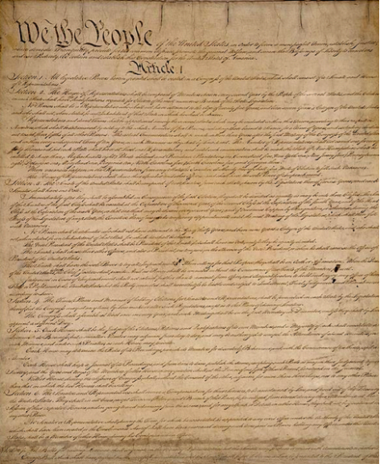
The Constitution: Structure and Principles
The Constitution is the highest form of law in the United States.

Slide 2
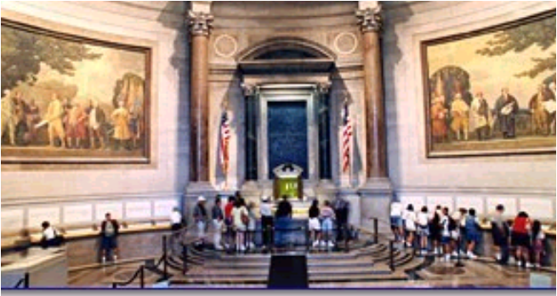
The U.S. Constitution
The Founders created the Constitution with the desire to set up a republic, power held in elected representatives. It set up a separation of powers to ensure this. Our government’s success depends on its citizens being informed. An understanding of the constitution is key to understanding American government.

Slide 3
The U.S. Constitution
Compared with other Constitutions, the U.S. Constitution is simple and brief.
The Constitution is a blueprint, or guide, for government but does not spell out every aspect of how government will function.
The Constitution contains 7,000 words and is divided into three parts: the Preamble, the articles, and the amendments.

Slide 4
Structure of the Constitution
or, how the document is set up.

Slide 5
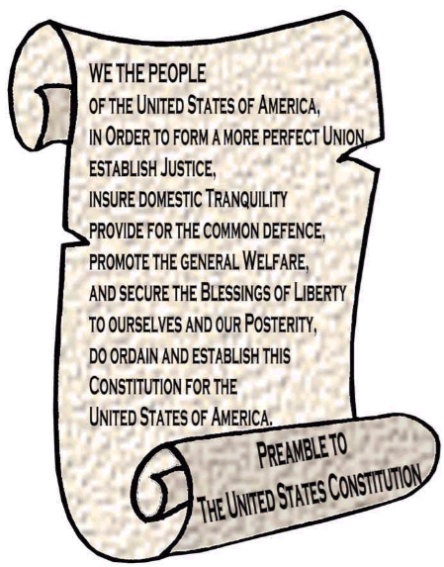
The Preamble
The introduction, which states why it was written.
The founders wanted a government which would:
1. provide stability and order,
2. Protect citizen’s liberties,
3. Serve the people.

Slide 6
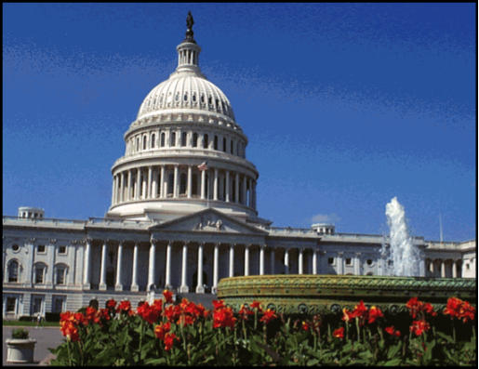
Seven Articles
There are seven divisions, or articles, which cover a general topic.
Article I establishes the legislative branch, procedures for making laws, and powers Congress does not have.

Slide 7
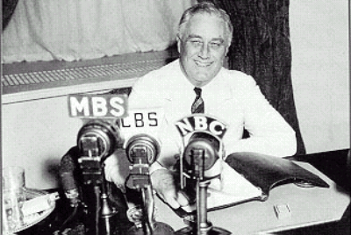
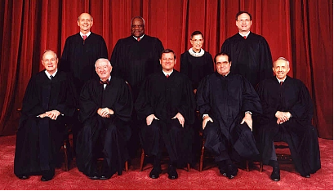
Seven Articles
Article II creates an executive branch to carry out laws passed by Congress.
Article III establishes a Supreme Court to head the judicial branch.

Slide 8
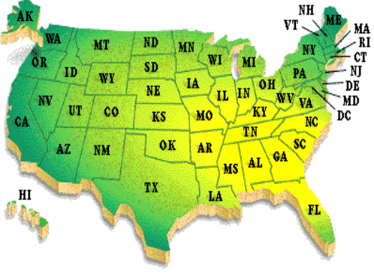
Seven Articles
Article IV explains the relationship of states to one another and to the national government.
Each state must give citizens of other states the same rights.
The national government will protect the states against invasion.

Slide 9
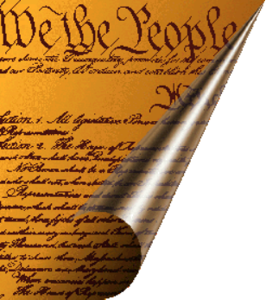
Seven Articles: The Amendment Process
Article V states that Amendments may be proposed and ratified in two ways.
The process illustrates the federal system of American government.
They are proposed on a national level but they are ratified on a state-by-state basis.
ArticleV

Slide 10
Seven Articles: Proposing Amendments
1)An amendment can be proposed by a two-thirds vote of each house of Congress.
OR
2) A constitutional convention called by congress at the request of two-thirds of the states. (This method has never been used.)

Slide 11
Seven Articles: Ratifying Amendments.
1) An amendment can be ratified by three-fourths of the 50 state legislatures.
OR
2)Three-fourths of special constitutional conventions called by the 50 states.
The amendment becomes part of the constitution upon ratification.

Slide 12
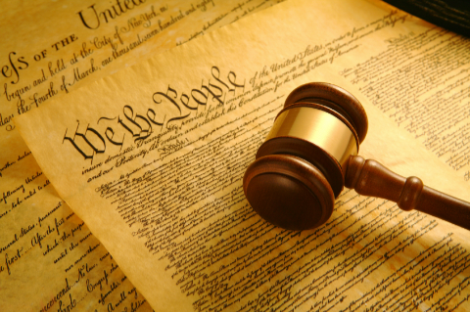
Seven Articles
Article VI contains the supremacy clause, establishing the Constitution as the “supreme Law of the Land”

Slide 13
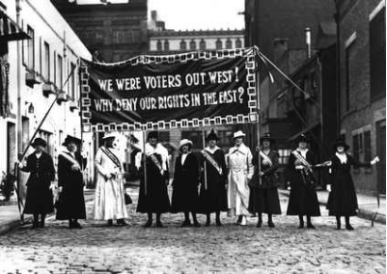
The Amendments
The final part is the amendments, or changes.
It has been amended or changed 27 times in our nation's history.
The process provides a way to meet the needs of a changing nation.

Slide 14
Six Major Principles
The Constitution rests on the following principles of government:

Slide 15
Popular Sovereignty
The people are the source of government power.

Slide 16
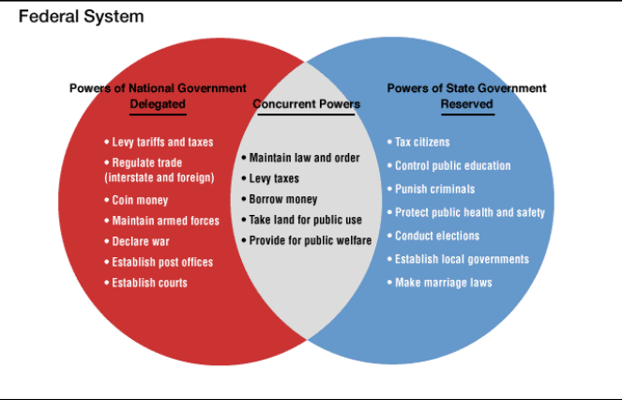
Federalism
Power is shared between the national and state governments.
This is a middle ground between the Articles and a Unitary form of government. It provides a flexible system of government.

Slide 17
Separation of Powers
Each of the three branches of government has its own responsibilities.
The Founders hoped this would prevent any one branch from gaining too much power.

Slide 18
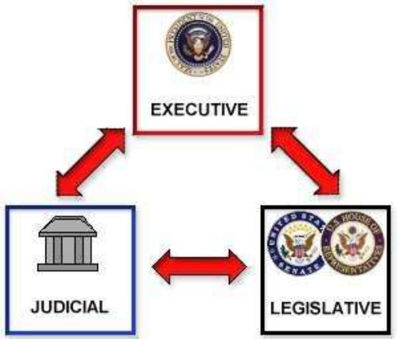
Checks and Balances
Each branch holds some control over the other branches.

Slide 19
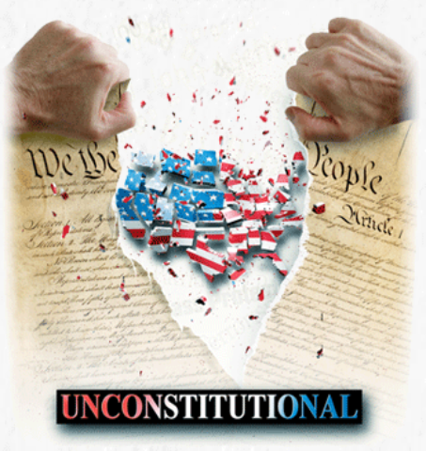
Judicial Review
Courts have the power to declare laws and actions of Congress and the President unconstitutional.
This was established by Marbury v Madison in 1803.
A decision can only be changed by another Court decision or an Amendment.

Slide 20
Limited Government
The Constitution limits the powers of government by specifically listing powers it does and does not have.

