Slide 1
Welcome Back! American History
Mrs. Blalock-Edwards

Slide 2
Welcome Parents!
Mrs. Blalock-Edwards

Slide 3
American History 8/9/2018
Do Now:
Find sheet on seating chart
Objective:
I will understand the goals and procedures of this class
Agenda:
Introduction
Syllabus
School goals and expectations
Why study history?
Homework:
Have syllabus signed by parent

Slide 4
American History 8/14/2018
Do Now:
What is the difference between liberal and conservative?
Objective:
Students will be able to differentiate between liberal and conservative ideologies
Agenda:
Introduction to liberal vs. Conservative
Video on ideologies
Activity: Conservative vs. Liberal
Homework:
Have syllabus signed by parent

Slide 5
American History 8/16/2018
Do Now:
Define Liberal
Define Conservative
Objective:
Students will be able to differentiate between liberal and conservative ideologies
Agenda:
Video on ideologies
Activity: Conservative vs. Liberal
Homework:
Have syllabus signed by parent

Slide 6
American History 8/18/2018
Do Now:
Grab Liberal vs. Conservative Sheet
Objective:
Students will be able to understand the causes of the civil war
Agenda:
Notes: Causes of the Civil War
Video civil war
Activity: Causes of civil war
Homework:

Slide 7
American History 8/18/2018
Do Now:
Grab Sectionalism sheet on back table
Objective:
Students will be able to understand the causes of the civil war
Agenda:
Activity: Causes of the Civil War Gallery Walk
Video: America the Story of Us, Division
Causes of the Civil War Jigsaw
Homework:
Finish questions from activity

Slide 8
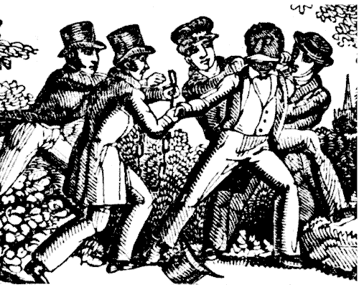
American History 8/22/2018
Do Now:
Uncle Tom’s Cabin
Objective:
Students will be able to understand the causes of the civil war
Agenda:
Finishing Causes of the Civil War.
The Fugitive Slave Act
12 Years a Slave
Homework:
Finish questions from activity

Slide 9
American History 8/19/2018
Do Now:
Grab Fugitive slave act sheet on back table
Objective:
Students will be able to understand the causes of the civil war
Agenda:
Causes of the Civil War Jigsaw
America the Story of Us: Division (30 min)
Homework:
Finish questions from activity

Slide 10
American History 8/24/2018
Do Now:
How did the Civil War end slavery
Objective:
Students will be able to understand the causes of the civil war
Agenda:
54th Massachusetts solder's battle diary
Movie: Glory
Homework:
Finish questions from activity

Slide 11
American History 8/28/2018
Do Now:
54th Massachusetts
Objective:
Students will be able to understand the causes of the civil war
Agenda:
54th Massachusetts solder's battle diary
Movie: Glory
Homework:
Finish questions from activity

Slide 12
American History 8/26/2018
Do Now:
Grab Robert Shaw handout
Objective:
Students will be able to understand the causes and consequences of the civil war
Agenda:
54th Massachusetts solder's battle diary
Movie: Glory
Homework:
Finish questions from activity

Slide 13
American History 09/01/2018
Do Now:
The effects of the Civil War
Objective:
Students will be able to understand the causes and consequences of the civil war
Agenda:
Group Assignment: Reconstruction Jigsaw
Intro to Presentation
Homework:
Study notes

Slide 14
“Imagine that you have two sons. Your older son has been bullying and fighting your younger son. The older son says he is upset because the younger son gets more attention. You punish your son, and he responds by running away from home. Before he leaves, he steals $500 from you. What would you do when your son returns? Would you punish him harshly so he won’t do it again, or be lenient with him if he promises not to do it again? Explain your choice.”

Slide 15
American History 9/01/18
Do Now:
Grab Reconstruction handout
Objective:
Students will be able to describe how our nation rebuilt after the civil war.
Agenda:
Notes: Reconstruction
Group Assignment: Reconstruction Presentation
Homework:
Study notes

Slide 16
American History 9/02/18
Do Now:
Grab Reconstruction handout
Objective:
Students will be able to describe how our nation rebuilt after the civil war.
Agenda:
Notes: Reconstruction
Group Assignment: Reconstruction Presentation
Homework:
Study notes

Slide 17
American History 9/06/18
Do Now:
Start of Reconstruction
Objective:
Students will be able to describe how our nation rebuilt after the civil war.
Agenda:
What is reconstruction: Video
Reconstruction Project
Homework:
Study notes

Slide 18
American History 9/08/18
Do Now:
Reconstruction amendments
Objective:
Students will be able to describe how our nation rebuilt after the civil war.
Agenda:
What is reconstruction: Video
Reconstruction Project
Homework:
Study notes
Test Next Thursday

Slide 19
American History 9/12/18
Do Now:
Sharecropping
Objective:
Students will be able to describe how our nation rebuilt after the civil war.
Agenda:
Notes: End of reconstruction
Sharecroppers Story
Reconstruction review
Review game
Homework:
Study Review guide

Slide 20
American History 9/13/18
Do Now:
Reconstruction amendments
Objective:
Students will be able to describe how our nation rebuilt after the civil war.
Agenda:
Test review assignment
Reconstruction review game
Homework:
Study Review guide

Slide 21
American History 9/14/18
Do Now:
Plessy V. Ferguson
Objective:
Students will be able to describe how our nation rebuilt after the civil war.
Agenda:
Test review assignment
Reconstruction review game
Homework:
Study Review guide
Test Next Class Period

Slide 22
American History 9/25/18
Do Now:
5 Min to Study
Objective:
Students will be able to describe how our nation rebuilt after the civil war.
Agenda:
Test Reconstruction
689235
America the Story of Us (Westward)
Homework:
Study Review guide

Slide 23
American History 09/27/18
Do Now:
Manifest Destiny
Objective:
Students will be able to describe how our nation grew through westward expansion
Agenda:
America The Story of Us Westward
Notes westward expansion
Independent Practice: Constructed Response
Homework:
Review notes

Slide 24
American History 10/05/18
Do Now:
Who is Nat Love?
Objective:
Students will be able to describe how our nation grew through westward expansion
Agenda:
Project workday
Black Cowboys during Westward Expansion
Follow the rubric prompt
Additional materials are on table next to white board
Homework:
Review notes

Slide 25
American History 10/09/18
Do Now:
Why did African Americans move out West?
Objective:
Students will be able to describe how our nation grew through westward expansion
Agenda:
Project workday
Black Cowboys during Westward Expansion
Follow the rubric prompt
Additional materials are on table next to white board
Homework:
Review notes

Slide 26
American History 10/11/2018
Do Now:
The Homestead Act
Objective:
Students will be able to describe how our nation grew through westward expansion
Agenda:
Notes: Native Americans
Essay Prompt
Guided Reading Activity
Video: How the West Was Lost
Homework:
Study Review guide

Slide 27
American History 10/15/2018
Do Now:
Describe the Battle at Little Big Horn and its affect on the Sioux Tribe.
Objective:
Students will be able to describe how our nation grew through westward expansion and the impact on native tribes.
Agenda:
Video: 30 Days on a Native American Reservation. Use sheet to answer questions.
Assume the role of a Plains Indian. Write a journal describing what the Dawes act is and how you feel about it.
How it has affected the people in your tribe? Use page 175 in your textbook
Homework: Enjoy your Break!

Slide 28
Westward Expansion Descriptive Writing
Assume the role of a Plains Indian. Write a journal entry describing how you feel about the Dawes Act and how it has affected your life.
Use page 175 in your textbook.

Slide 29
American History 10/24/2018
Do Now:
California Gold Rush
Objective:
Students will be able to describe how our nation grew through westward expansion
Agenda:
Review Study Guide
Westward Expansion Review Game
Homework:
Test Next Class
Study!!!!

Slide 30
American History 10/26/2018
Do Now:
Objective:
Students will be able to describe how our nation grew through westward expansion
Agenda:
Test Westward Expansion
America the Story of Us: Cities
Homework:
None

Slide 31
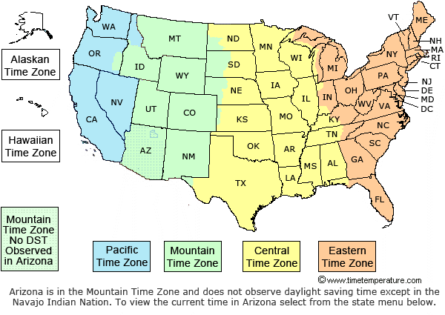
American History 10/30/2018
Do Now:
Railroads and Timezones
Objective:
I will be able to describe how technology changed our country
Agenda:
Video: America the story of us Cities
Notes: Introduction to the American Industrial revolution
Homework:
Review Notes

Slide 32
Exit Slip Questions
Name three inventions that changed our country.
Next tell what impact they have on our country today.

Slide 33
American History 11/1/2018
Do Now:
Industrial Revolution
A patent is a form of intellectual property. A patent gives its owner the right to exclude others from making, using, selling, and importing an invention for a limited period of time
Objective:
I will be able to describe how technology changed our country
Agenda:
Notes: Introduction to the American Industrial revolution
Graphic organizer over long and short term effects of Idustrialization
Constructed Response Chapter 5, section 1 questions
Homework:

Slide 34
American History 11/05/2018
Do Now:
What are Monopolies, Cartels and Trusts?
Objective:
I will be able to describe how technology changed our country
Agenda:
Inventions assignment
Video and Questions: Men Who Built America
Introduction to Inventions Project
Homework:
Read Chapter 5

Slide 35
American History 11/19/2018
Do Now:
Who is Andrew Carneige?
Objective:
I will be able to describe how technology changed our country
Agenda:
Inventions Hall of Fame Project Presentations
Men Who Built America: Rockefeller
Homework:

Slide 36
American History 10/24/17
Do Now:
Time Zones
Objective:
I will be able to describe how technology changed our country
Agenda:
Notes: Chapter 5 Industrialization
Pre-Reading: Madame C.J. Walker
Men Who Built America: Rockefeller
Homework:

Slide 37
American History 10/30/17
Do Now:
Organized Labor Movement
Objective:
I will be able to describe how technology changed our country
Agenda:
Guided Reading Activity
Men Who Built America: Morgan
The Jungle: Reading
Homework:
Test Friday

Slide 45
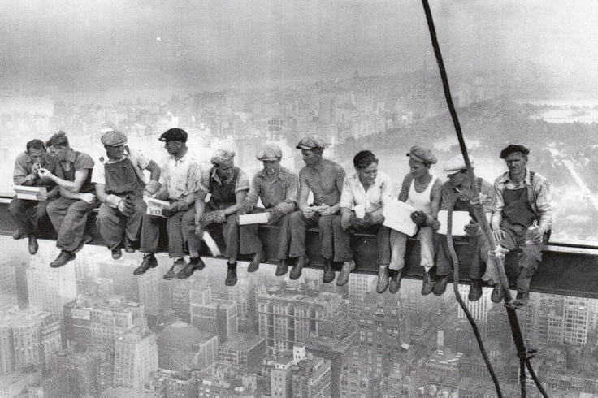

Slide 46
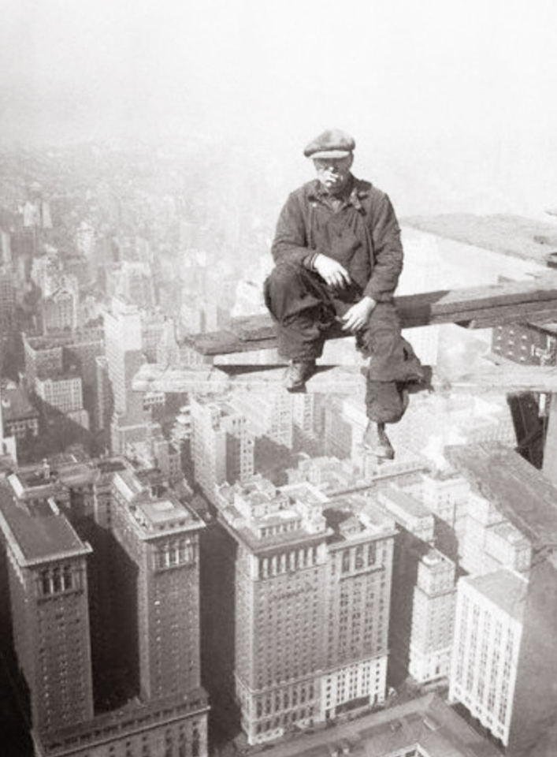

Slide 49
American History 11/01/18
Do Now:
Monopolies, Trust and Cartels
Objective:
I will be able to describe how technology changed our country
Agenda:
Independent Practice: Complete Study Guide
Group Discussion: Review and Recall Chapter 5
Group Activity: Kahoot Review
Homework:
Test Friday

Slide 50
American History 11/07/18
Do Now:
Patents
Objective:
I will be able to describe how technology changed our country
Agenda:
The Jungle
Create three newspaper headlines about the conditions at the meat packing plant
Industrialization Kahoot
Homework:
Test next class period!
Study!!!

Slide 51
American History 11/07/18
Do Now:
Patents
Objective:
I will be able to describe how technology changed our country
Agenda:
Test Industrialization
790325
Progressive Era Webquest
Homework:
Test next class period!
Study!!!

Slide 52
American History 11/13/18
Do Now:
What is the Progressive Era
Objective:
I will be able to describe the impact of urbanization on modern America
Agenda:
Notes: Progressive Era
Progressive era video: Teddy Roosevelt
Shame of the cities
Homework:
Finish “The jungle”

Slide 53
American History 11/15/18
Do Now:
What is the Progressive Era?
Objective:
I will be able to describe the impact of urbanization on modern America
Agenda:
Notes: Progressive Era
Progressive Era Carousel Activity
Shame of the cities
Homework:
Finish “The jungle”

Slide 54
American History 11/21/18
Do Now:
Who is WEB DuBois?
Objective:
I will be able to describe the impact of urbanization on modern America
Agenda:
Notes: Progressive Era
Three Visions for African-Americans
Comparing Black Progressive Reformers
Homework:
Have a safe and happy Thanksgiving!

Slide 55
American History 11/28/18
Do Now:
Shame of the Cities
Objective:
I will be able to describe the impact of urbanization on modern America
Agenda:
Comparing Black Progressive Reformers
Mudbound film analysis. After Film, you will write an essay comparing the lives of blacks and whites during the progressive era
Homework:
None

Slide 56
American History 1/24/18
Do Now:
Pre-Test Questions
Objective:
I will be able to describe the impact of WWI on the United States and the world
Agenda:
Notes: Introduction to WWI
Video: The World at War
Independent practice: Causes of World War I
Homework:
None

Slide 57
American History 1/26/18
Do Now:
Causes of WWI
Objective:
I will be able to describe the impact of WWI on the United States and the world
Agenda:
Notes WWII: US Entry into the war
Video: America in the 20th Century
Guided Practice: Causes of US Entry into War
Homework:
Effects of war

Slide 58
American History 1/30/18
Do Now:
What is Trench Foot?
Objective:
I will be able to describe the impact of WWI on the United States and the world
Agenda:
Notes: End of WWI
DBQ: Justification for United States entering war
WWI video Shell Shock
Homework:
None

Slide 59
American History 2/01/18
Do Now:
Treaty of Versailles
Objective:
I will be able to describe the impact of WWI on the United States and the world
Agenda:
Video Clip: African Americans during WWI
Review guide over WWI (Chapter 9)
Homework:
Double Puzzle Review Guide
Test: Monday

Slide 61
American History 2/05/18
Do Now:
Describe the country’s condition after WWI
Objective:
I will be able to describe the impact of WWI on the United States and the world
Agenda:
WWI video Shell Shock
WWI Study Guide
Kahoot Review Game
Homework:
None

Slide 62
American History 2/7/18
Do Now:
Create three questions you believe will be on the test. Share your question and answers with a partner
Objective:
I will be able to describe the impact of WWI on the United States and the world
Agenda:
Test (WWI) 355732
Webquest Jazz Age
Homework:
None

Slide 63
American History 2/9/18
Do Now:
Roaring 20s
Objective:
I will be able to describe the impact of WWI on the United States and the world
Agenda:
The Roaring 20s Web Quest
America the Story of Us: Boom
Notes: Intro to the Roaring twenties
Homework:
None

Slide 64
American History 2/21/18
Do Now:
Understanding words in context. Read passage and write what term means above words in bold.
Objective:
I will be able to describe the impact of the roaring 20s on the United States.
Agenda:
Notes: The Roaring Twenties
Video: Many Rivers to Cross. African Americans during the 20th Century
Reading in historical context: 1920s
Homework:
Finish Timeline

Slide 65
American History 2/23/18
Do Now:
What is the meaning of Langston Hughes Poem “I too, sing America”?
Objective:
I will be able to describe the impact of the roaring 20s on the United States.
Agenda:
Notes: The Roaring Twenties
Video: Many Rivers to Cross. African Americans during the 20th Century
Guided Reading Activity
Homework:
Finish Timeline

Slide 66
American History 2/27/18
Do Now:
Sequencing events on a timeline
Objective:
I will be able to describe the impact of the roaring 20s and the Great Depression on the United States.
Agenda:
Independent practice: Review Guided Reading activity
Notes/Discussion: What are the causes of the Great Depression?
Video: Life during the Great Depression
Homework:
None

Slide 67
American History 3/07/2018
Do Now:
How did President Hoover handle the Great Depression?
Objective:
I will be able to describe the impact of the Great Depression on the United States.
Agenda:
Notes: Hoover vs. Franklin Roosevelt
Constructed Response Questions
Board Activity: The Depression Presidents
Essay: A comparison of two presidents during the Great Depression
Homework:
None

Slide 69
American History 3/13/2018
Do Now:
Who is Eleanor Roosevelt?
Objective:
I will be able to describe the impact of the Great Depression on the United States.
Agenda:
Board Activity: The Depression Presidents
Essay: A comparison of two presidents during the Great Depression
Kitt Kittrage Movie
Homework:
None

Slide 70
Essay
Compare and contrast the presidencies and depression policies of Herbert Hoover and Franklin D Roosevelt.
1 ½ pages

Slide 71
American History 03/09/18
1.List five characteristics/attributes/accomplishments of each president
2. Pick a person to write the information on the board.

Slide 72
American History 3/19/18
Do Now:
What is the Black Blizzard?
Objective:
I will be able to describe how President Roosevelt tried to get the country out of the Great Depression
Agenda:
Review: Roaring twenties and Great Depression
Review Game
Kitt Kittrage/ With Questions
Homework:
Study for test next period

Slide 73
American History 3/21/18
Do Now:
5 Min to Study
Objective:
I will be able to describe how President Roosevelt tried to get the country out of the Great Depression
Agenda:
Test: Roaring twenties and Great Depression
650025
For web quest go to blalockt.weebly.com and click the World War II web quest assignment under assignments/test
Homework:
Have a great spring break!

Slide 74
American History 04/02/2018
Do Now:
Historian’s Notebook
Objective:
I will be able to describe The changes our country made during WWII
Agenda:
America The Story of Us (WWII
Introduction to WWII Notes and Guided Response Questions
Homework:
Review Notes

Slide 75
American History 04/4/2018
Do Now:
Charles Drew
Objective:
I will be able to describe The changes our country made during WWII
Agenda:
Notes: Rise of Hitler
Map of WWII Activity
WWII Dictators Graphic organizer
Homework:
Review Notes

Slide 76
American History 04/6/2018
Do Now:
American on the Homefront
Objective:
I will be able to describe The changes our country made during WWII
Agenda:
Notes: Causes of WWII
Dictators Graphic organizer
Video: Band of Brothers
Homework:
Review Notes

Slide 77
Dictator Graphic Organizer
Create a graphic organizer using the following dictators.
1. Match up the dictator with his symbol, then cut and put it on the organizer
2. write a brief summary about the dictator and their role as head of their country

Slide 78
American History 4/10/2018
Do Now:
African Americans during WWII
Objective:
I will be able to describe The changes our country made during WWII
Agenda:
Tuskegee Airmen Film with Viewing guide.
Dictators Graphic organizer
Essay: America on the Homefront
Homework:
Review Notes
Test Next Wednesday

Slide 79
American History 4/12/2018
Do Now:
The Holocaust
Objective:
I will be able to describe The changes our country made during WWII
Agenda:
Tuskegee Airmen
Review Study Guide
Homework:
Review Notes

Slide 80
American History 04/16/18
Do Now:
Victory in Europe
Objective:
I will be able to describe The changes our country made during WWII
Agenda:
Review Guide: WWII
Activity: Review Game
Homework:
Test Wednesday

Slide 81
American History 04/20/18
Do Now:
5 min to study
Objective:
I will be able to describe The changes our country made during WWII
Agenda:
Test WWII
Test ID: 886639
America The Story of Us: Superpower
Homework:
None

Slide 82
American History 4/24/18
Do Now:
Cold War
Objective:
I will be able to identify the cause and effect of the Cold War
Agenda:
America the Story of Us: Superpower
Notes: Why A Cold War
Vocabulary Review
Activity: Mapping the Cold War
Homework:
Review Notes

Slide 83
American History 4/1717
Do Now:
What is the Cold War?
What two nations were involved?
Objective:
I will be able to identify the cause and effect of the Cold War
Agenda:
Activity: Mapping the Cold War 533, 536 and A14
The Cuban Missile Crisis
Homework:
Review Notes

Slide 84
American History 4/1817
Do Now:
What is the Cold War?
What two nations were involved?
Objective:
I will be able to identify the cause and effect of the Cold War
Agenda:
Activity: Mapping the Cold War 533, 536 and A14
The Cuban Missile Crisis
Homework:
Review Notes

Slide 85
American History 4/30/18
Do Now:
Cold War
Objective:
I will be able to identify the cause and effect of the Cold War
Agenda:
Hidden Figures ( list instances where they talk about the Cold War or Russia
The Cuban Missile Crisis
Homework:
Review Notes

Slide 86
American History 05/14/18
Do Now:
CNN Student News
Objective:
I will be able to identify the changes America made during the late 20th century.
Agenda:
Final Study Guide
Homework:
Study

Slide 87
American History 05/1/17
Do Now:
The Red Scare
Objective:
I will be able to identify the cause and effect of the Cold War and Civil Rights
Agenda:
Hidden Figures
Cold War Review
Introduction to Civil Rights movement
Homework:
Review Notes

