Slide 1
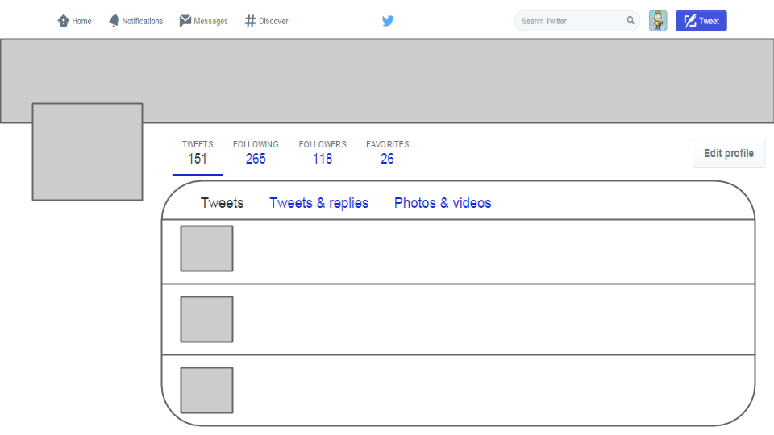
Place Header Image First
(Size to Grey Box)
Place Profile
Image Second
(Size to Grey Box)
Name
@Username
Name@Username
Type your tweet here.
A short bio of yourself
Name@Username
Type your tweet here.
Name@Username
Type your tweet here.

