Slide 1
Outcome: The New Kingdom
Ancient Egypt & Judaism

Slide 2
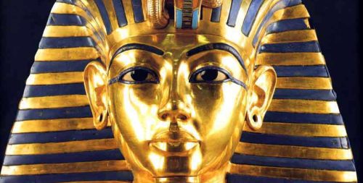
The New Kingdom
Setting the Stage: The Middle Kingdom
The Old Kingdom fell apart due to weak leadership
The Middle Kingdom would not be as powerful as either the Old or New Kingdoms and would be defined when it was invaded by the Hyksos

Slide 3
The New Kingdom
The Hyksos
Asiatic Nomads who invaded during Egypt’s Middle Kingdom
Did not rule a large territory
The Hyksos ruled from 1640-1570 B.C.
Capital was at Memphis with summer residence at Avaris
Prince Kamose would seek to rid Egypt of foreign Hyksos
Kamose fought the Hyksos until his death
Kamose’s brother Ahmose would rise to power and defeat the Hyksos ten years later around 1570 B.C.
Result: Egypt was once again ruled by Egyptians

Slide 4
The New Kingdom
The Golden Age
The Old Kingdom was known for its pyramids
The New Kingdom will be known for conquest and building of temples in the Valley of the Kings

Slide 5
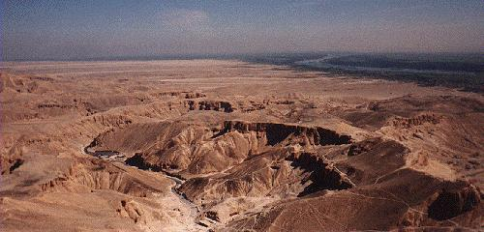
Valley of the Kings

Slide 6
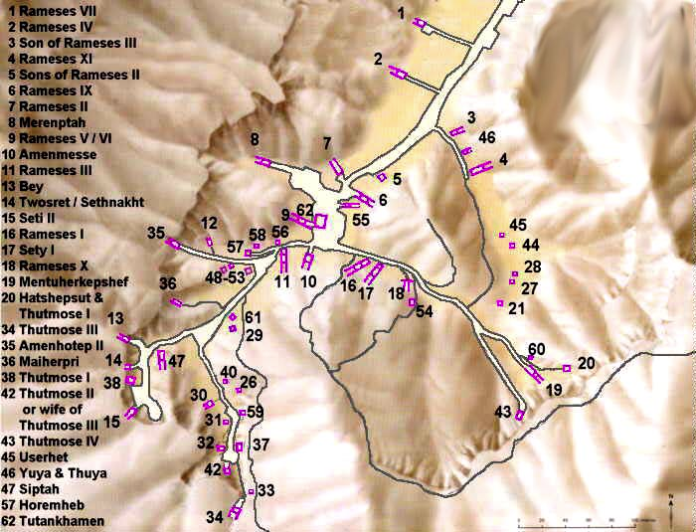

Slide 7
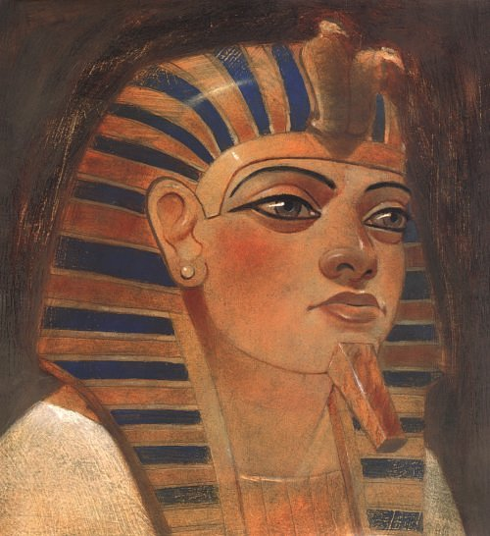
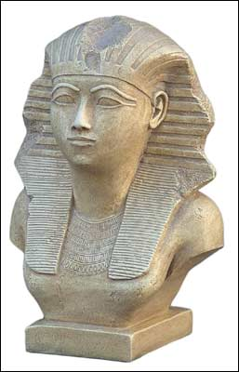
New Kingdom Pharaohs
Hatshepsut

Slide 8
The New Kingdom
The New Kingdom Pharaohs
Hatshepsut
Stepson who was heir to the throne was too young to rule
Declared herself pharaoh around 1472 B.C.
Encouraged trade rather than waging war (smart!)
Her reign was very prosperous
Made herself up to look like a male to gain support
Planned a very elaborate tomb in the Valley of the Kings: Deir el-Bahri
Almost did not survive history due to the actions of her stepson Thutmose III

Slide 9
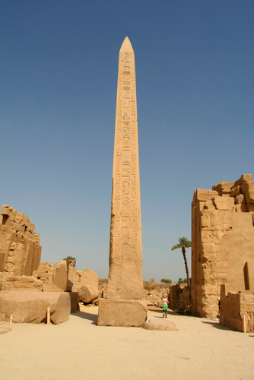
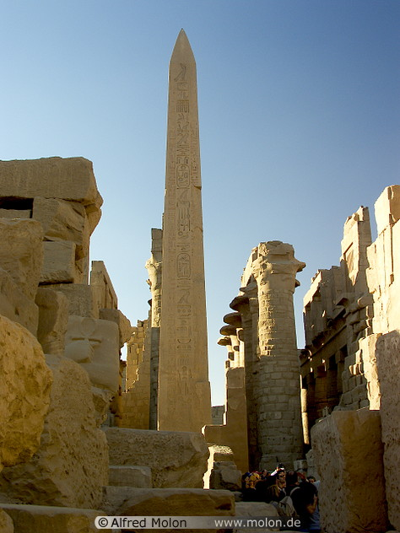
Hatshepsut built Obelisks

Slide 10
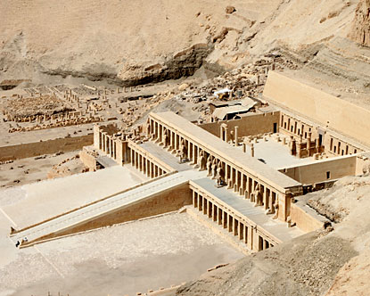
Deir el-Bahri

Slide 11
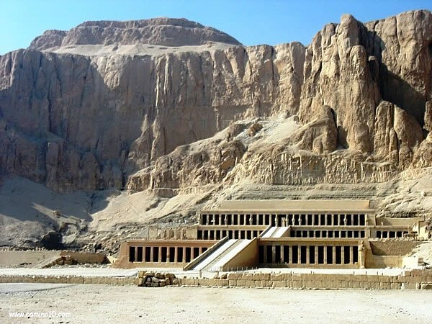

Slide 12
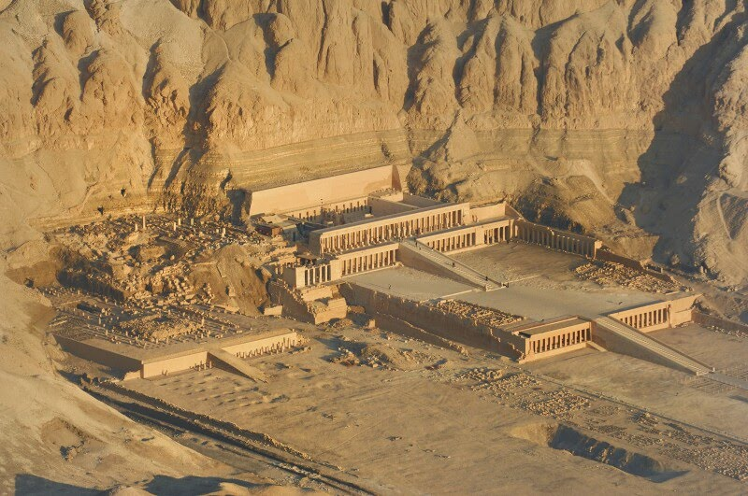

Slide 13
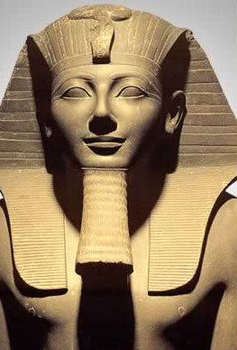
Thutmose III

Slide 14
The New Kingdom
Thutmose III
Much more warlike than Hatshepsut
Eager to take power; may have murdered Hatshepsut
Had any picture of Hatshepsut destroyed ---> Egyptians believed this erased your soul from the afterlife
Armies pushed south into Nubia ---> peak of Egyptian reign

Slide 15
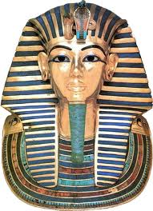
King Tut

Slide 16
The New Kingdom
King Tut
History remembers King Tutankhamen more for the discovery of his tomb in 1922 by Howard Carter rather than his reign as pharaoh
Only ruled for about 10 years, was only about 18 when he died
Possibly died of infection in broken leg and malaria

Slide 17
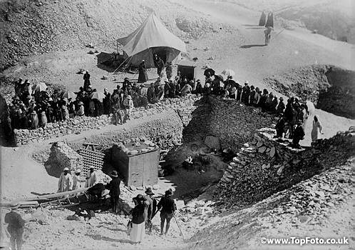
Discovery of Tut’s Tomb

Slide 18
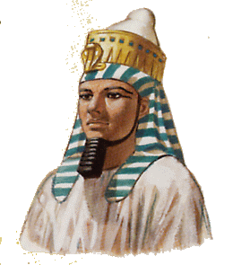
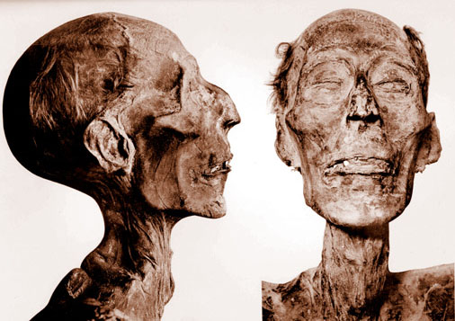
Rameses the Great

Slide 19
The New Kingdom
Ramses II
Made a peace treaty with neighboring Hittites which lasted almost 100 years
Created great temple to god Amon-Re at Karnak
Created magnificent temple at Abu Simbel
Four giant statues of himself
Had to be moved due to rising waters of Lake Nasser
Enormous ego; had hundreds of statues carved of himself
Estimates show he had well over 100 children
Worshipped himself as a god
Reigned for 67 years; died at roughly age 90

Slide 20
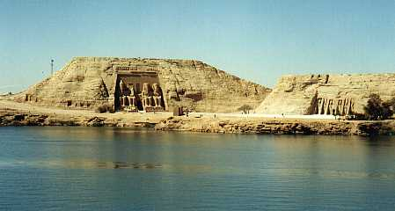
Abu Simbel

Slide 21
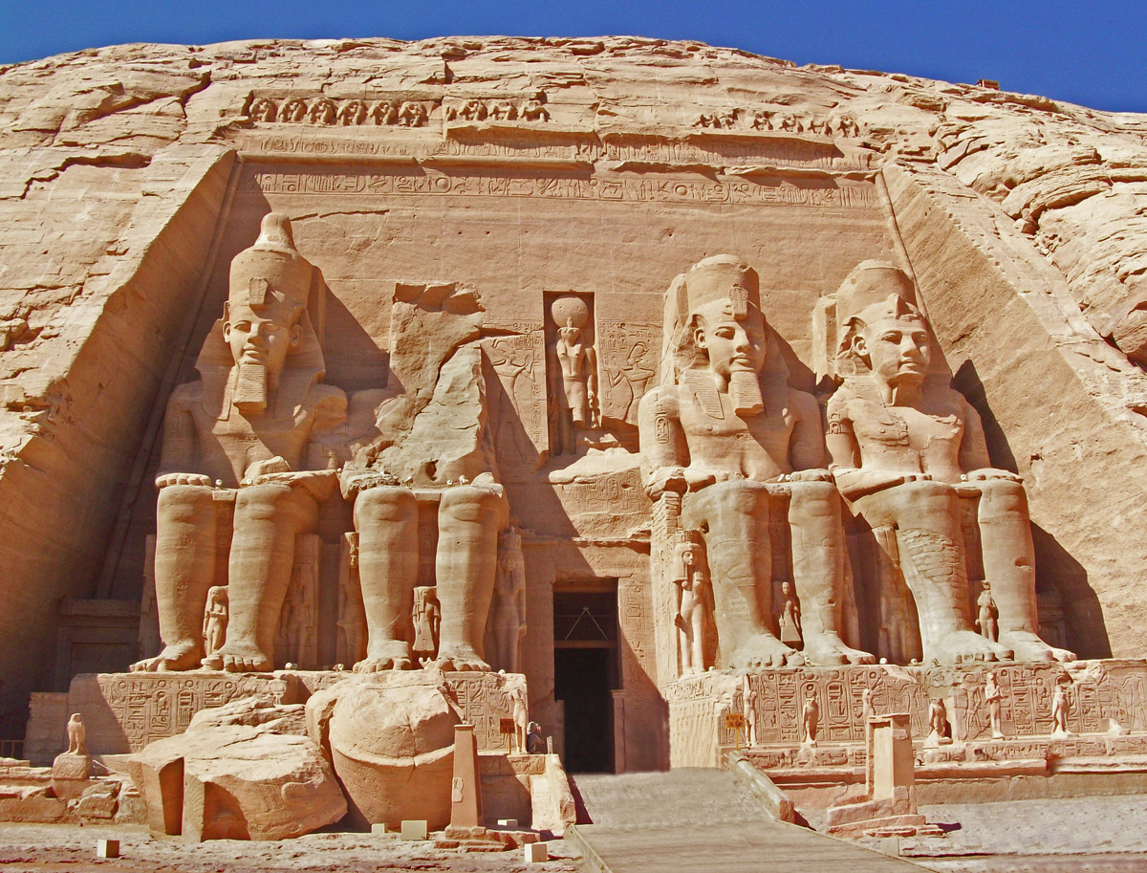

Slide 22
The New Kingdom
Downfall of the New Kingdom
The New Kingdom would see many successors to Ramses II but none with as great of power
Many of Ramses II heirs would bicker over power
Ramses III is considered to be the last great New Kingdom pharaoh
Eventually the Philistines, Libyans, and Hittites would reduce Egypt to a series of broken up regional units
Another powerful foe would eventually move in and dominate: The Assyrians

Slide 23
The New Kingdom
The Assyrians
The Assyrians were a mighty military machine
They used ladders to scale city walls
Used iron tipped spears, swords, and daggers
Used torture to demoralize their enemy
Tunneled under city walls to attack enemies
Capital was Nineveh; home to library with 20,000 clay tablets
Defeated by a combined army of Medes and Chaldeans

Slide 24
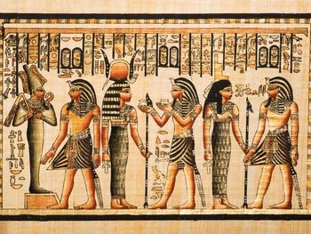
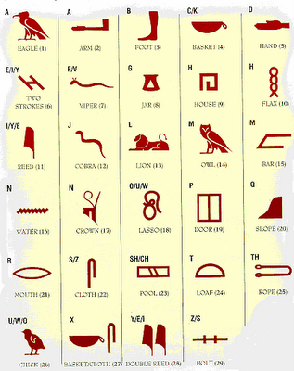
The New Kingdom
Result: The Egyptians ruled Egypt the New Kingdom for roughly 500 years before they were eventually replaced by the Nubians and Assyrians, thus ending Egyptian rule of the territory. Though their people have disappeared, the Ancient Egyptians left us with an amazing culture that built pyramids/tombs/obelisks, carved hieroglyphics, mummified bodies, and stood out as one of the most unique peoples of the ancient world

