Slide 1
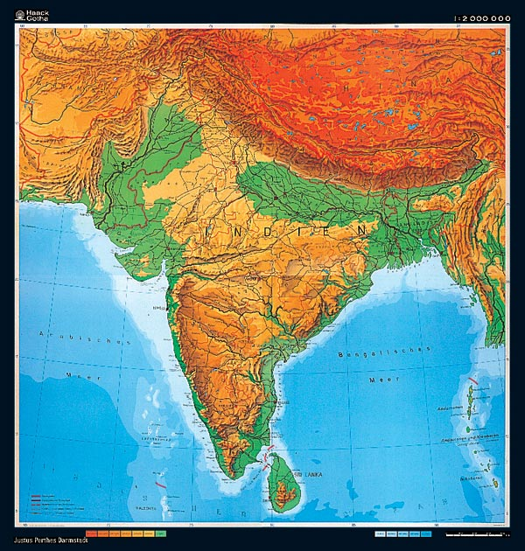
India
Outcome: Geography & Early Civilization

Slide 2
Constructive Response Question
Describe the geography of the Indian Subcontinent:

Slide 3
What will we learn?
Geography of India
Indus River Valley cultures
End of the Indus River Valley cultures

Slide 4
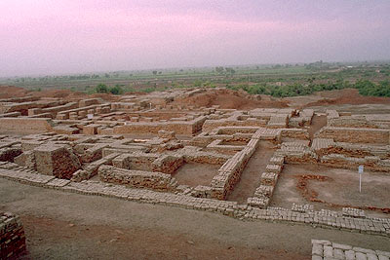
Geography & Early Civilization
Setting the Stage
Historians know less about the origins and eventual decline of early Indian cultures because the language of the culture has not been translated yet.

Slide 5
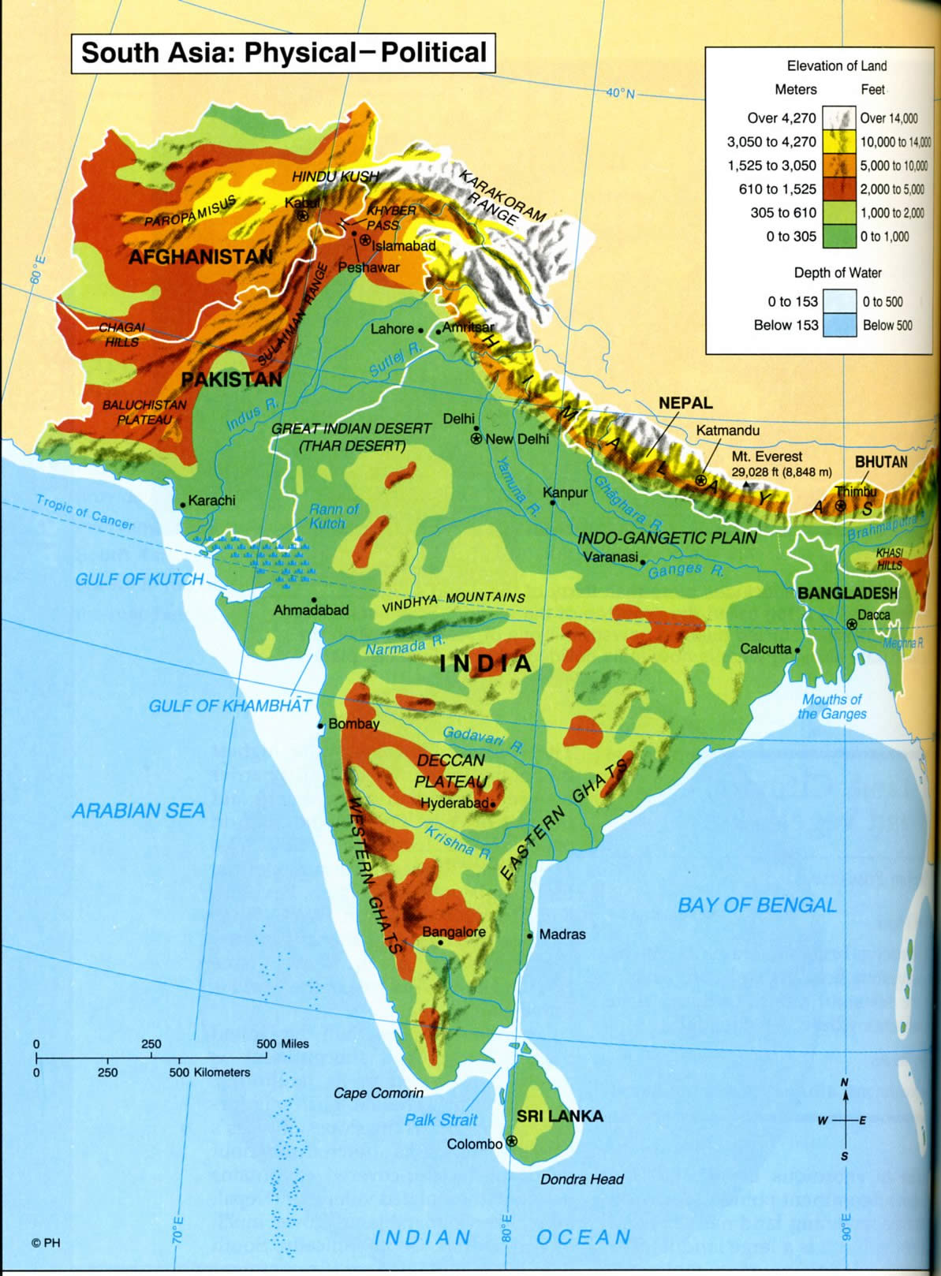
Indian Sub-Continent

Slide 6
Geography & Early Civilization
The Geography of the Indian Subcontinent
India, Pakistan, and Bangladesh make up the landmass of the Indian Subcontinent
This region is separated from Asia by several mountain ranges, some of the tallest in the world
Hindu Kush, Karakorum, & Himalayas

Slide 7
Indian Sub-Continent Mountain Ranges

Slide 8
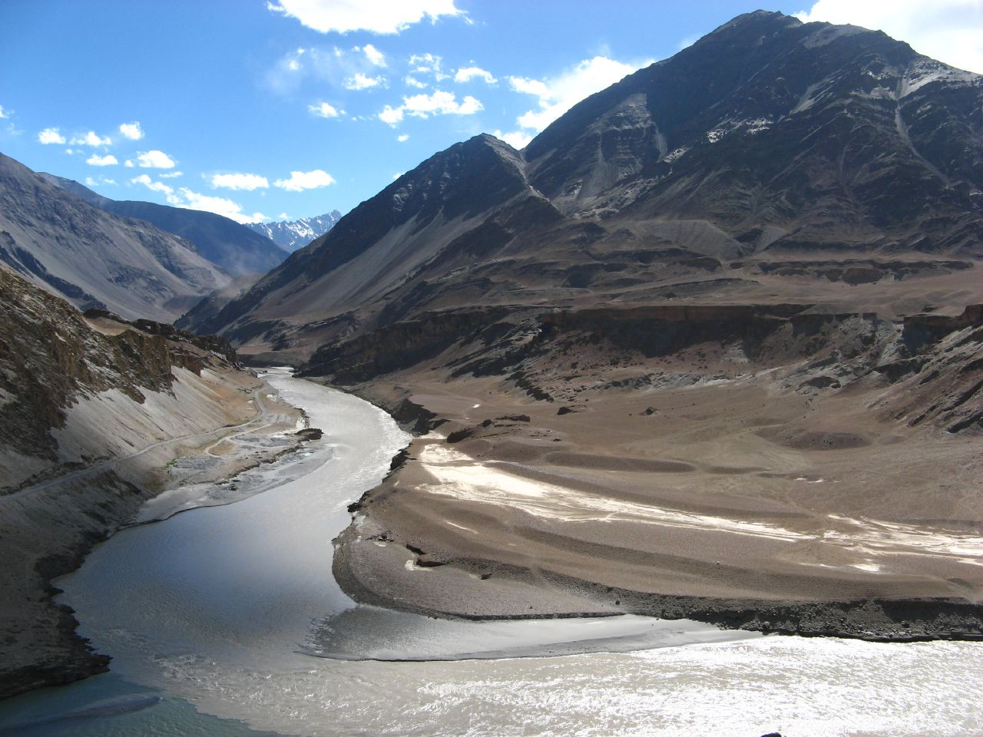
Geography & Early Civilization
Indus River
Farming is only possible in the areas directly watered by the Indus
Much of the lower Indus Valley is occupied by the Thar Desert

Slide 9
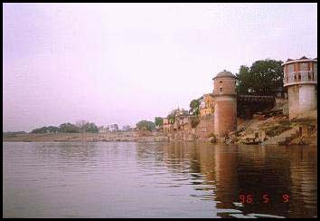
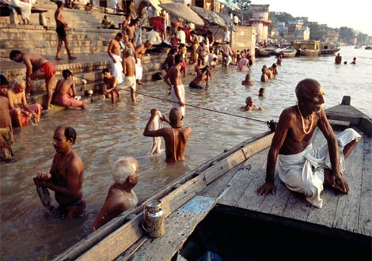
Geography & Early Civilization
Ganges River
The Ganges flows from the Himalayas and flows across northern India
It joins the Brahmaputra River as it flows into the Bay of Bengal

Slide 10
Indian Sub-Continent River Systems

Slide 11
Geography & Early Civilization
Together these rivers make up a large area called the Indo-Gangetic Plain which was great for agriculture, transportation, and irrigation
Seasonal winds called monsoons dominate India’s climate
Environmental challenges
Yearly floods- unpredictable
The rivers sometimes change course
Monsoons brought unpredictable cycles of wet and dry seasons

Slide 12
Indian Sub-Continent Indo-Gangetic Plain

Slide 13
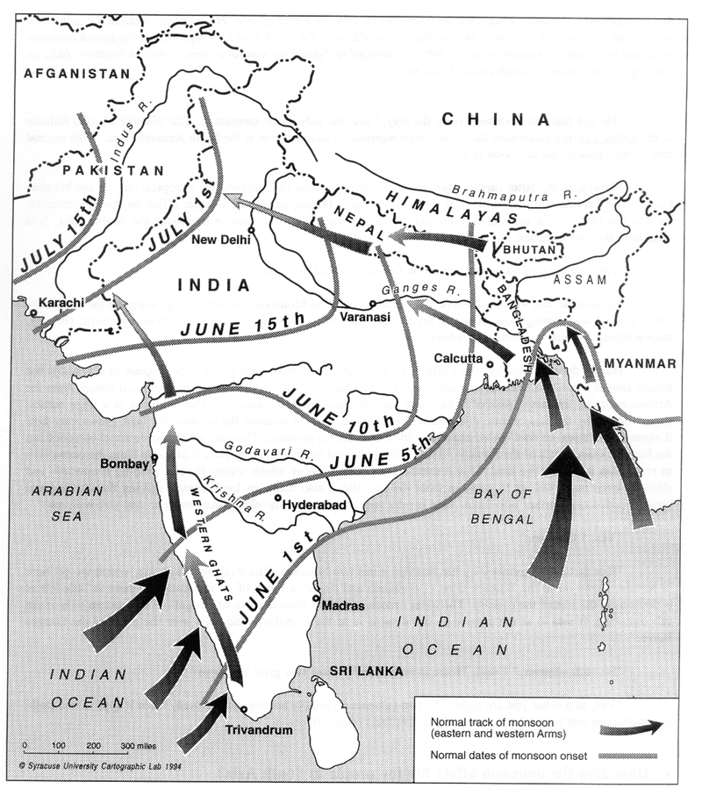
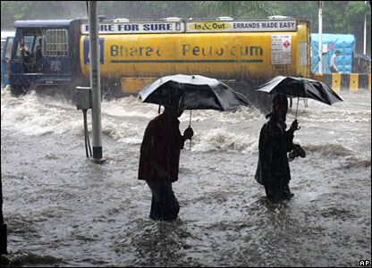
Monsoons

Slide 14
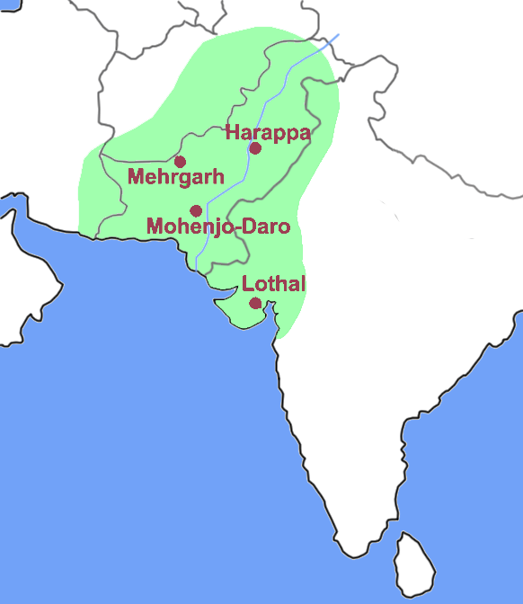
Early Civilization Along the Indus

Slide 15
Geography & Early Civilization
Civilization Emerges on the Indus
Historians have yet to decipher the Indus system of writing
Still unclear when civilization began but evidence shows that people were using domesticated goats and sheep around the year 7000 B.C.
The Indus Valley civilization is sometimes called the Harappan Civilization because of many archeological discoveries made there
City planning was one of their most remarkable achievements
They used a grid system unlike Mesopotamia’s maze of winding streets
Engineers used an advanced plumbing system that rivaled 19th century plumbing
This uniformity suggests that the Indus people had a strong central government

Slide 16
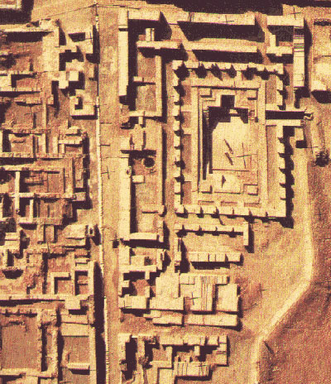
Grid System
Mohenjo-Daro

Slide 17
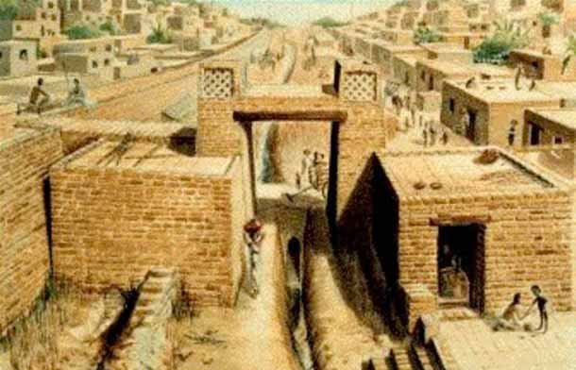
Plumbing

Slide 18
Geography & Early Civilization
Harappan Culture
Housing separations suggests divisions in society were not great
Artifacts of toys and clay pots suggest a relatively prosperous society
Few items of warfare found suggesting that conflict was limited
Animals were very important
Historians believe that Harappan civilization used a theocracy, Hindu connection?

Slide 20
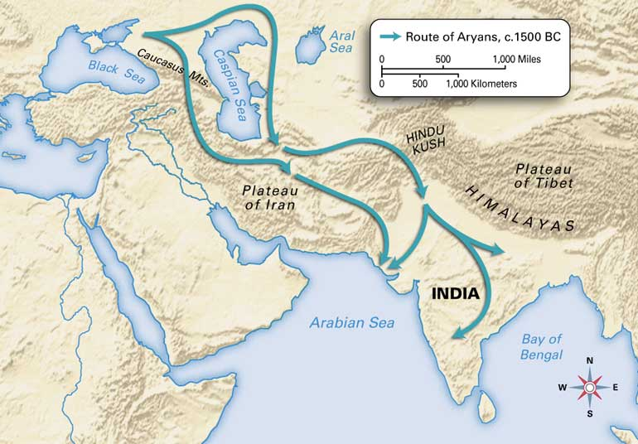
Geography & Early Civilization
Indus Valley Culture Ends
Evidence found in the 1970s suggests that a shift in tectonic plates may have caused earthquakes, flooding, and caused the Indus to change course
Some cities survived the disasters but other cities food supplies were affected
Later a group of people called the Aryans would sweep into the area and take control

Slide 21
Constructive Response Question
Describe the geography of the Indian Subcontinent:

