Slide 1
Outcomes: The Rise of Islam & Beliefs of Islam
Islam

Slide 2
Constructive Response Questions
How was the development of Islam similar & different to Christianity?
Describe the core beliefs of a Muslim:

Slide 3
What will we learn?
Origin of Islam
Core beliefs of Islam
Connections to Judaism & Christianity

Slide 4
The Arabian Peninsula

Slide 5
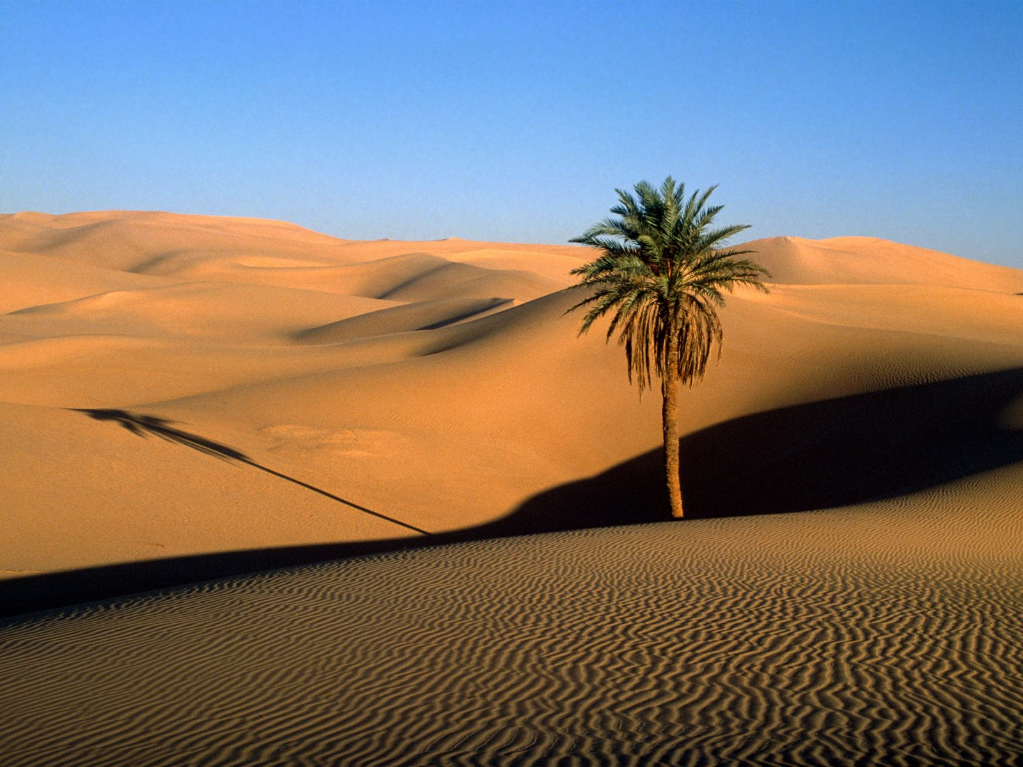
The Rise of Islam
Setting the Stage: The Arabian Peninsula
Connection to 3 Continents
Africa, Asia, and Europe
Mostly desert with few oases for little agriculture
Desert inhabited by nomadic Arab herders

Slide 6
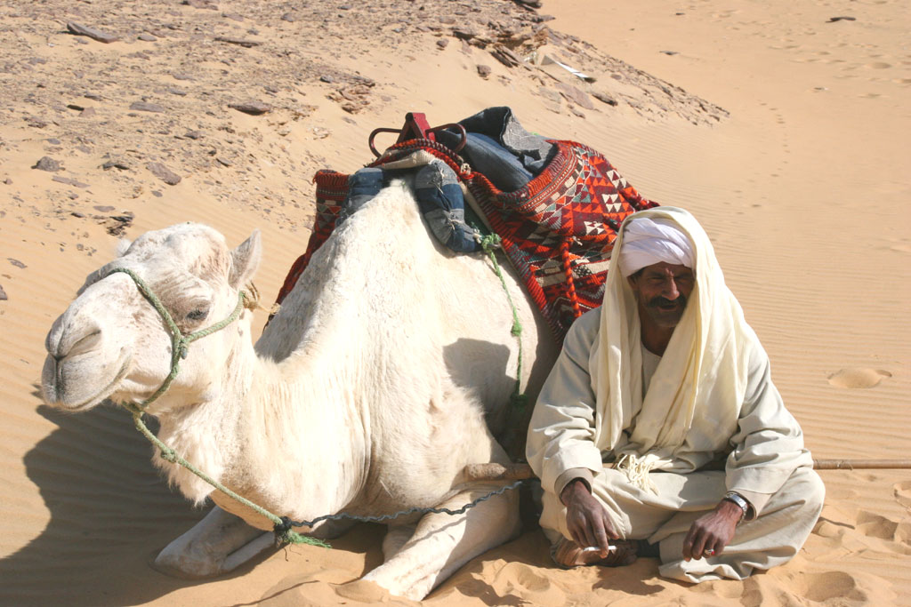
The Rise of Islam
Bedouins: Arab nomads organized into tribes and clans
Had ideals of courage & loyalty to the family
Possessed warrior skills
Would become part of Islamic way of life

Slide 7
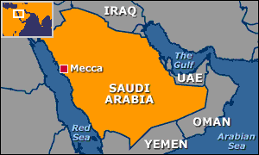
The Rise of Islam
Mecca: City in Western Arabia (Modern day Saudi Arabia)
Ka’aba: ancient shrine people came to worship at
Black stone- built by Abraham and son Ishmael
Contained 360 idols worshipped by many tribes

Slide 8
The Ka’aba

Slide 9
The Ka’aba

Slide 10
The Rise of Islam
Muhammad
Orphaned at age 6 and raised by grandfather and uncle
At age 25 Muhammad became a businessman and trader
Married Khadijah, a businesswoman
Life changes: While meditating in a cave, he is visited by angel Gabriel who proclaims to Muhammad to preach message that there is only one true god
Began to preach and spread Islam
Not seen as divine (having extra power)

Slide 11
The Rise of Islam
Islam: Submission to will of Allah (god)
Muslim: One who has submitted

Slide 12
The Arabian Peninsula

Slide 13
The Rise of Islam
Hijrah & Return to Mecca
in 622 AD, Mohammad and followers leave Mecca for Medina and continue to spread Islam known as the Hijrah
Becomes “year 1” for Muslims
First mosque established for Islam
630 AD, Muhammad returns to Mecca and destroys the idols in the Ka’aba
Ka’aba becomes the most sacred site in Islam
Muhammad dies 2 years later at age of 62

Slide 14
Great Mosque in Mecca

Slide 15
The 5 Pillars of Islam

Slide 16
2. Islam Grows and Expands
Muhammad did not name a successor or instructed his followers on how to chose one
Tribal customs led to the election of Abu-Bakr, a loyal friend of Muhammad to be the successor
Abu-Bakr became the first caliph or “successor” or “deputy”
Later, disagreements over who should succeed caused a split in Islam
Shi’a, or Shi’ites believe that the caliph needed to be a descendent of Muhammad
Sunni Muslims acknowledge the first four caliphs as rightful successors of Muhammad even though they weren’t of same blood

Slide 17
Beliefs of Islam
Five Pillars
Faith: There is no god but Allah and Muhammad is the messenger of Allah
Prayer: Pray 5 times a day towards Mecca
Alms: Give alms (money for the poor)
Fasting: During holy month of Ramadan, Muslims fast between dawn and sunset
Pilgrimage: Must visit Mecca at one point in lifetime if capable. Known as the Hajj.

Slide 18
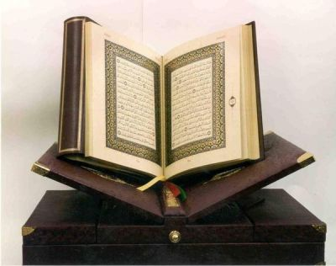
Beliefs of Islam
The Qur’an
Islamic holy text
Allah is the source of authority
Written in Arabic, only true version

Slide 19
Beliefs of Islam
Links to Judaism and Christianity
Muslims, Christians, and Jews trace ancestry back to Abraham
To Muslims, Allah is the same god that is worshipped in Christianity and Judaism
Qur’an is the word of Allah as revealed to Muhammad in the same way that Jews and Christians believe the Torah and the Gospels were revealed to Moses and the New Testament writers.
All three are “people of the book” due to their use of a holy book

Slide 20
Constructive Response Questions
How was the development of Islam similar & different to Christianity?
Describe the core beliefs of a Muslim:

