Slide 1
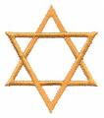
Ancient Egypt & Judaism
Outcome: The Origin of Judaism

Slide 2
The Origin of Judaism
Setting the Stage
Canaan was the ancient home of the Hebrews
Hebrews were later called Jews
The Hebrews history, legends, and moral laws have had a major influence on Western culture.
Part of their history is shared with Christianity and Islam

Slide 3
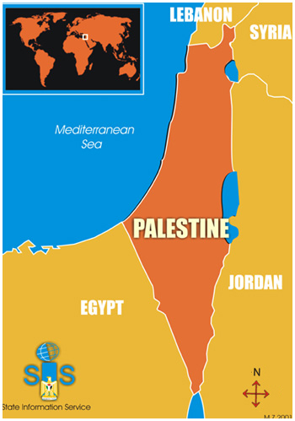
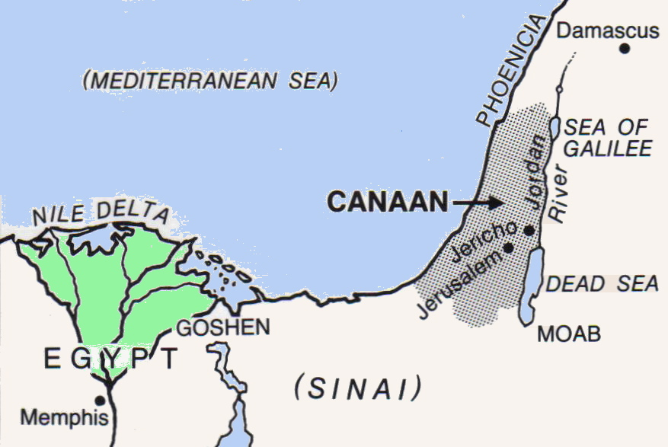
Palestine/Canaan

Slide 4
The Origin of Judaism
The Search for a Promised Land
Ancient Palestine’s location made it a crossroads of the ancient world.
Palestine: Region at the eastern end of the Mediterranean Sea.
The Hebrews settled in Canaan which was located in Palestine
According to the Bible, Canaan was the land God had promised to the Hebrews

Slide 5
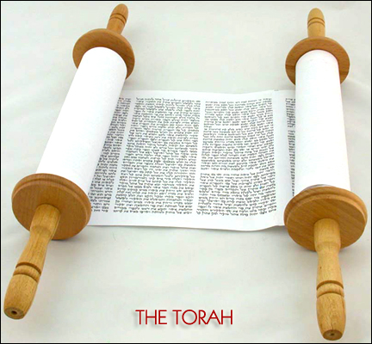
The Torah

Slide 6
The Origin of Judaism
Most of what we know of early Hebrew history is found in the first five books of the Hebrew Bible known as the Torah.
The Torah is the most sacred writings to the Hebrews and make up part of the Old Testament for the Christians
In the Torah, God chose Abraham to be the “father” of the Hebrew people
Abraham was a shepherd who lived in Ur; God commanded him to move his people to Canaan around 1800 B.C.
Around 1650 B.C. the descendents of Abraham moved to Egypt
The Hebrews were monotheistic and worshipped god Yahweh
Covenant: Promise made by Abraham and his people to obey Yahweh in return Yahweh had promised to protect Abraham and his descendents

Slide 7
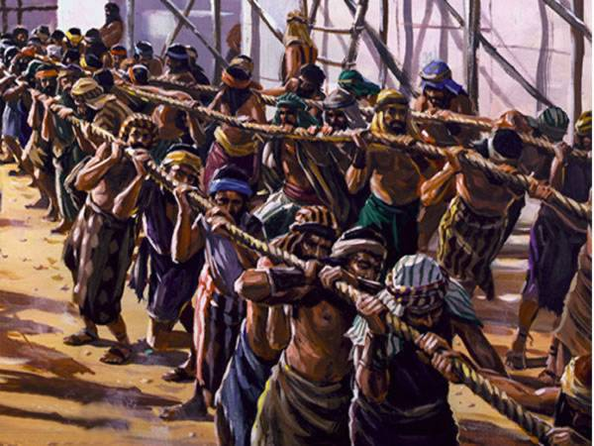
The Origin of Judaism
Moses and the Exodus
The Bible says the Hebrews migrated to Egypt due to drought and famine
At first they were accepted but later were forced into slavery

Slide 8
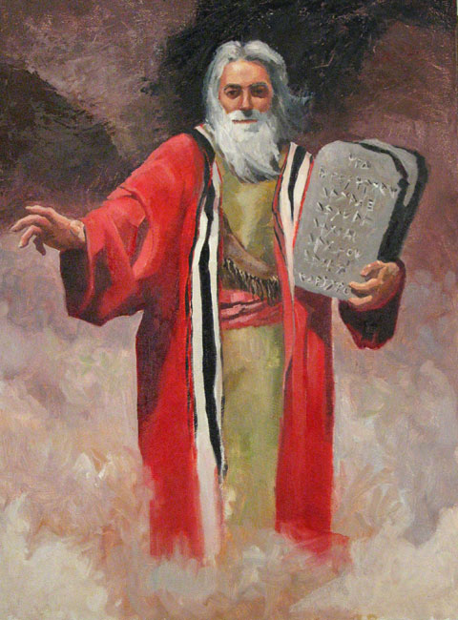
Moses

Slide 9
The Origin of Judaism
Moses
At the time of Moses’ birth, the Pharaoh felt threatened by the Hebrews and commanded that all first born males be killed
Moses’ mother laid him in the reeds of the Nile to save him
A Egyptian princess found him and raised him in luxury

Slide 10
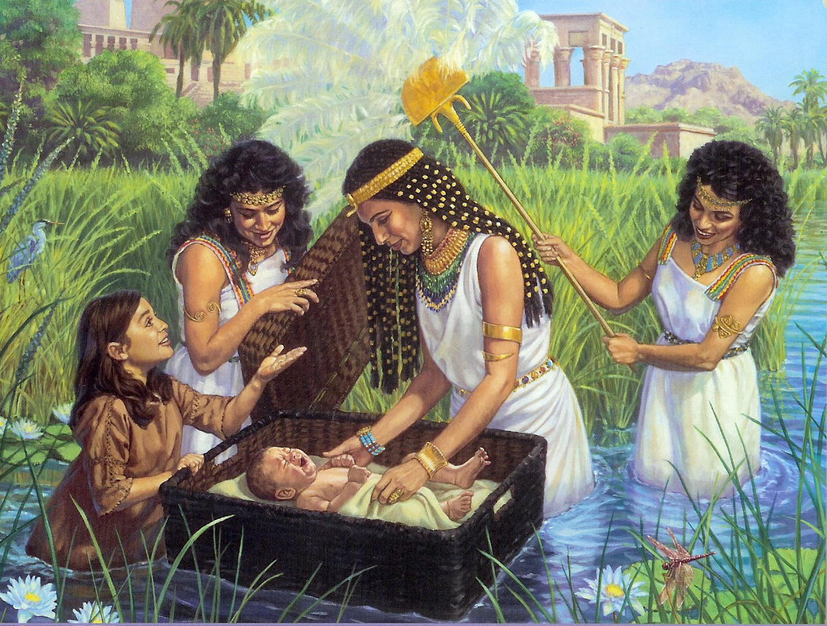
Baby Moses on the Nile

Slide 11
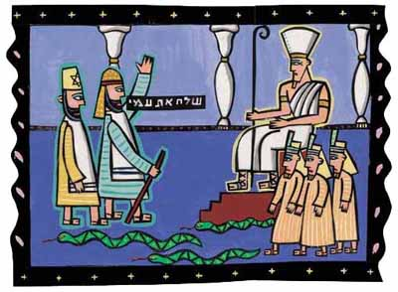
The Origin of Judaism
He did not forget his Hebrew birth but no one knew including the Pharaoh
Eventually Moses’ secret would get out and he became a slave
By the command of God he was told to lead the Hebrews out of Egypt
This became known as the Exodus; “Let my people go!”

Slide 12
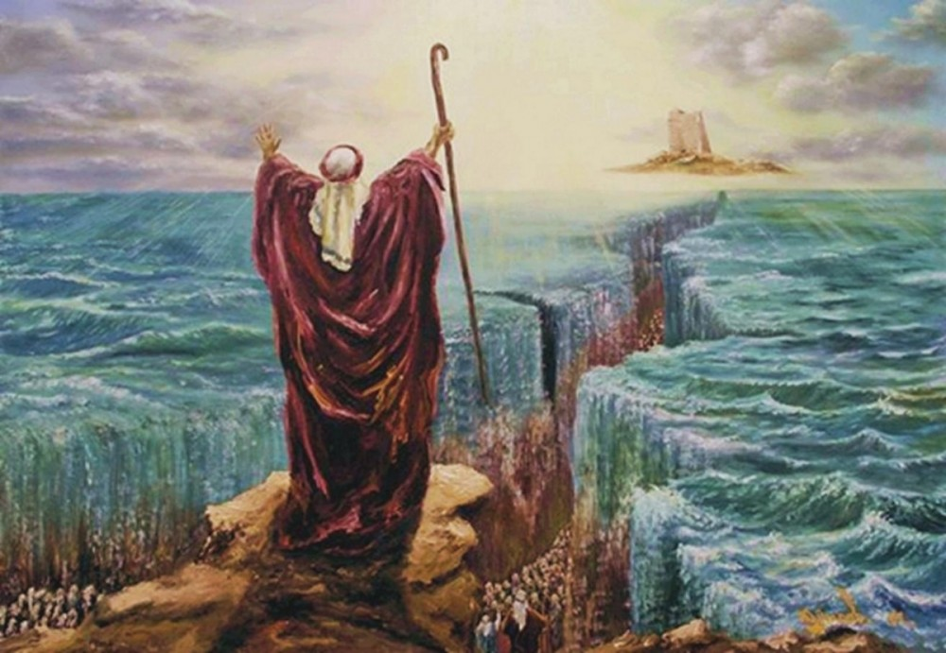
Moses Parting the Red Sea

Slide 13
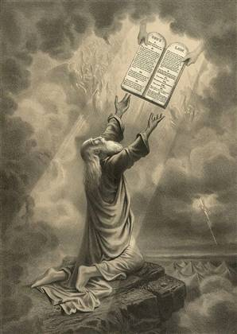
The Origin of Judaism
As the Hebrews traveled across the Sinai Peninsula, Moses went to the top of Mount Sinai to pray
The Bible says he spoke to God and was given the Ten Commandments
These Ten Commandments and other teachings became the basis of religious law of Judaism as well as Christianity

Slide 14
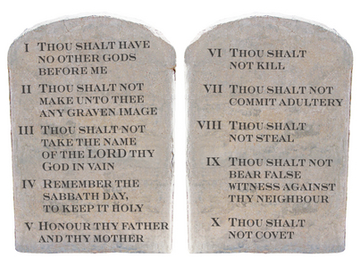
The Ten Commandments… Can you name them??

Slide 15
The Origin of Judaism
The Kingdom of Israel
Canaan was harsh with desert, rocky wilderness, and the hot valley of the Jordan River
The tribe of Judah was the last remaining of the Hebrews and were soon called the Jews with their religion Judaism
The Hebrews united under one kingdom of Israel
Israel as an official country would not be formed until 1948
Solomon became the most powerful of Hebrew kings and built a trading empire
He glorified the city of Jerusalem
Solomon built an important temple in Jerusalem called Solomon's Temple
The kingdom would divide in two: Israel in the north and Judah in the south

Slide 16
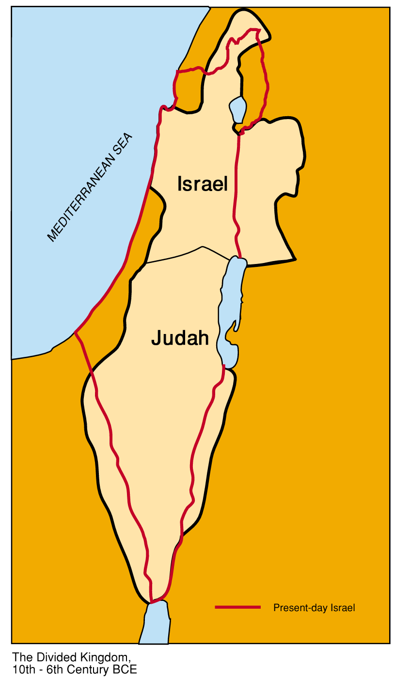
Israel & Judah

Slide 17
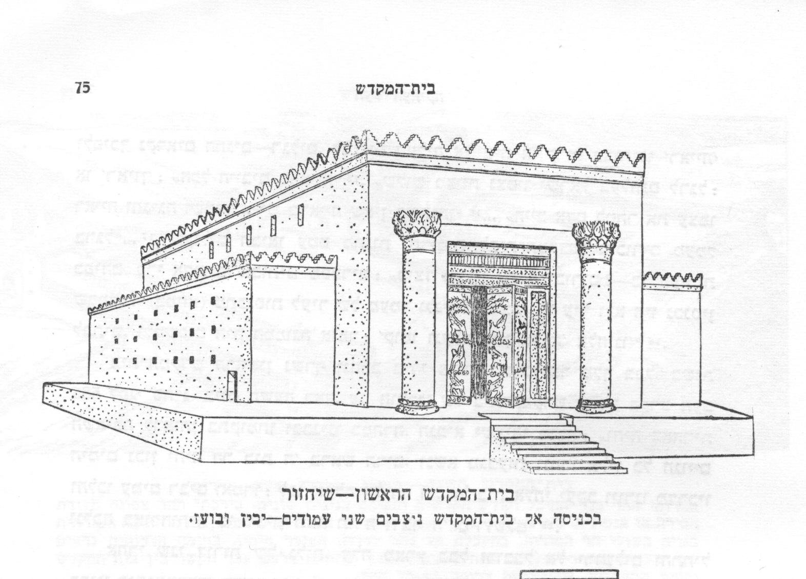
Solomon's Temple

Slide 18
The Origin of Judaism
The Babylonian Captivity
Eventually disaster struck: both Israel and Judah had to pay tribute to the Assyrians
Tribute: peace money paid by a weaker power to a stronger power
They paid the tribute to avoid being attacked but was not enough
In 725 B.C. the Assyrians invaded Samaria, the capital of Israel
By 722 B.C. the whole northern kingdom was under Assyrian control

Slide 19
The Origin of Judaism
The southern kingdom lasted another 150 years before falling to the Babylonians
The Assyrians had been losing control to Babylonian king Nebuchadnezzar
Solomon's Temple was destroyed by the Babylonians
In 539 B.C. Persian King Cyrus the Great took power and allowed many Hebrew exiles to return to Jerusalem to rebuild Solomon's Temple
Many others would dominate the region including the Persians, Greeks, and the Romans
Jerusalem is still a very important city for Jews, Christians, and Muslims

Slide 20
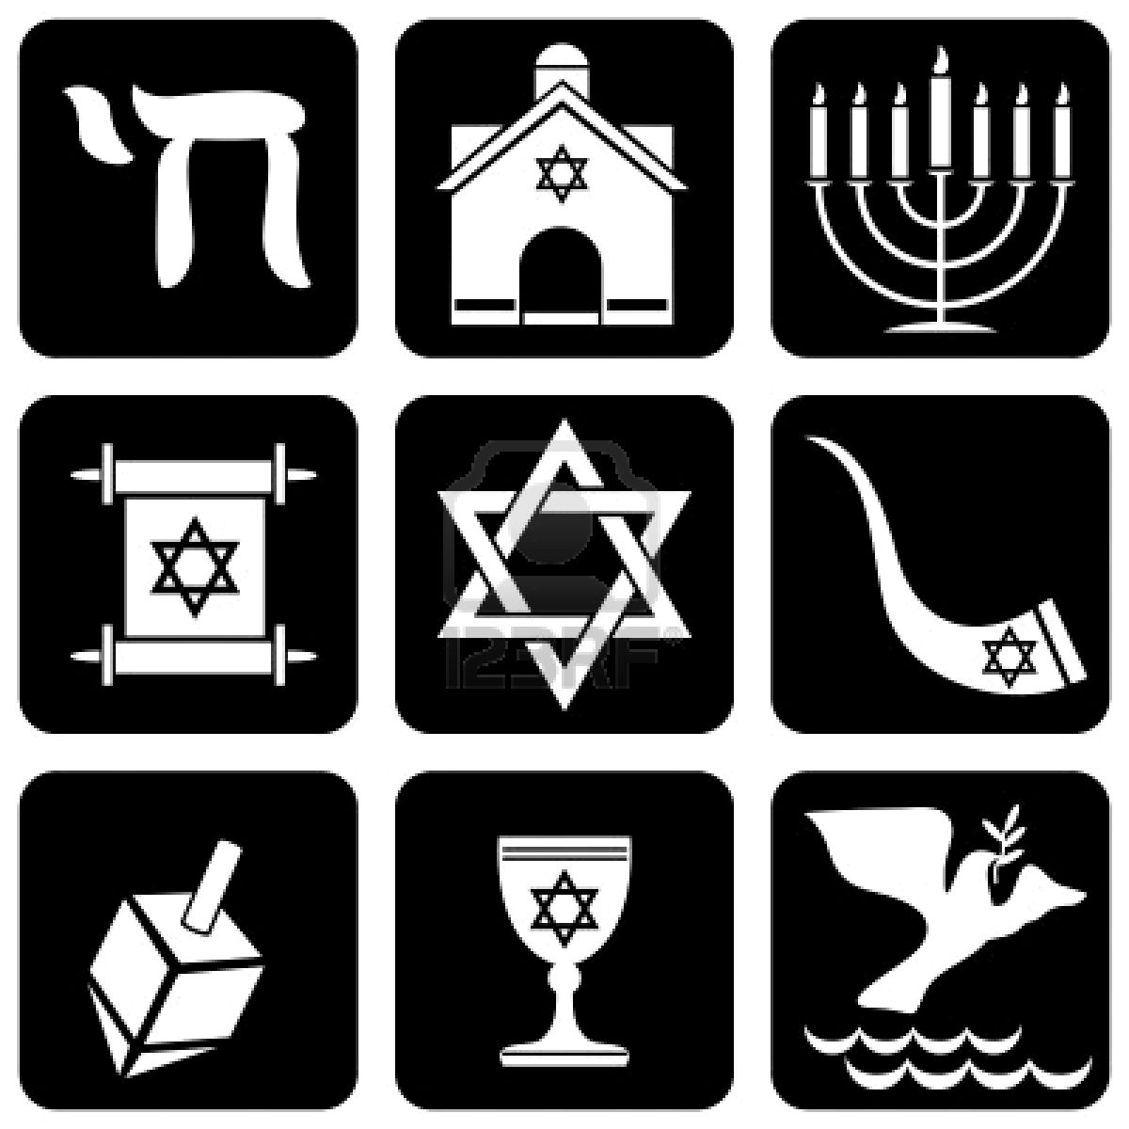
The Origin of Judaism
Result: The history of the Hebrews has been a long and arduous journey. Of the five major religions studied in this class, theirs will be the oldest and one of the most influential. Many of their practices and ideas would cross into many mainstream cultures today.

