Slide 1
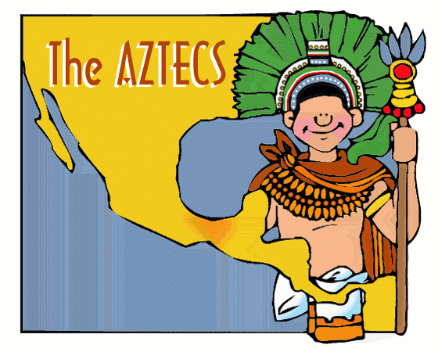
Mesoamerica
Outcome: The Aztecs

Slide 2
Constructive Response Question
Who were the Aztecs and what did they do?

Slide 3
What Will we learn?
Environment
Cities
Language/Writing
Economy
Government
Religion
Achievements

Slide 4
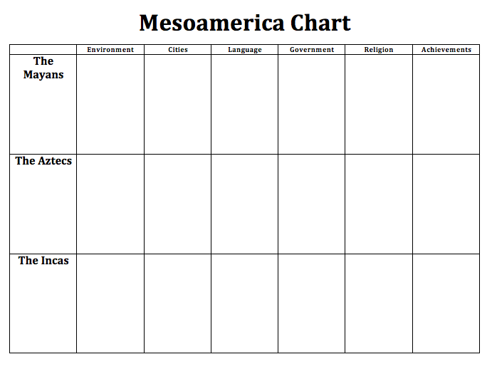

Slide 5
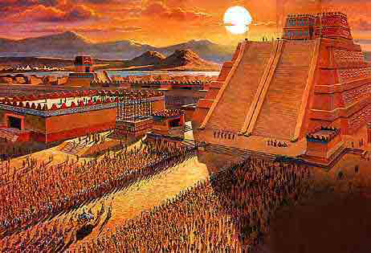
Peak of Aztec Power
Roughly 1325-1521

Slide 6
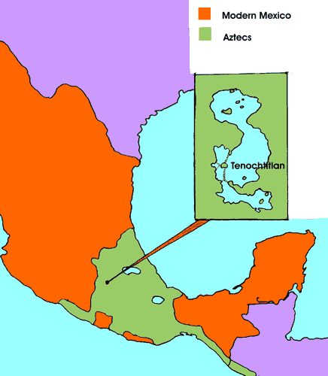
The Aztecs

Slide 7
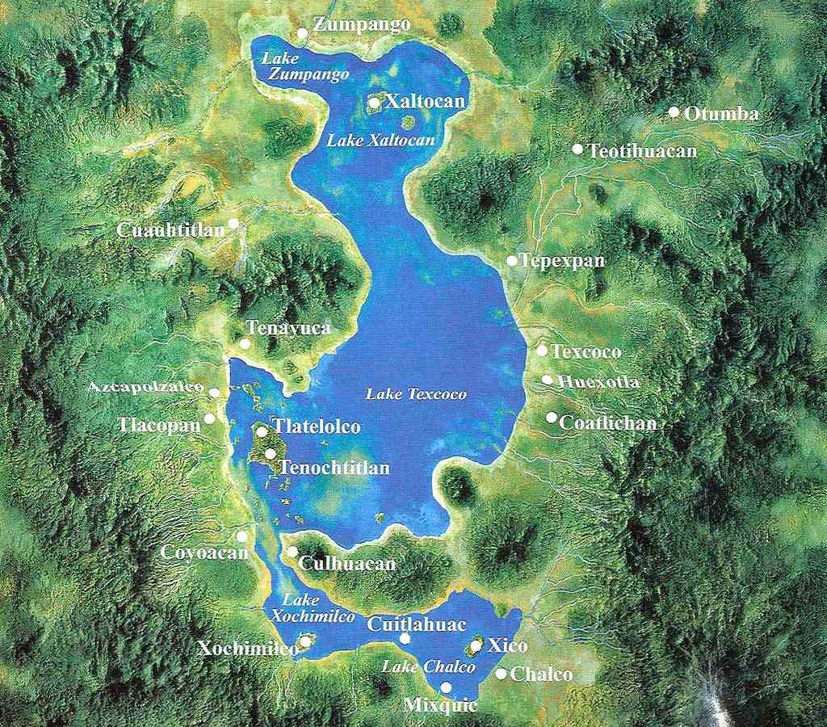
The Aztecs
Environment
Valley of Mexico
7,500 ft above sea level
Fertile soil
Several shallow lakes
Lake Texcoco

Slide 8
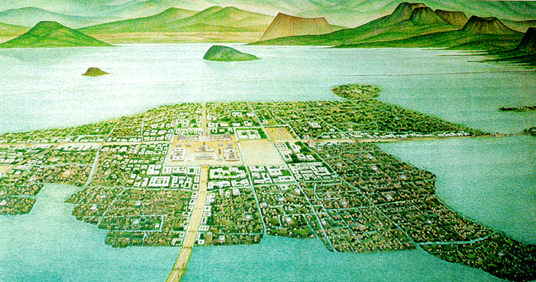
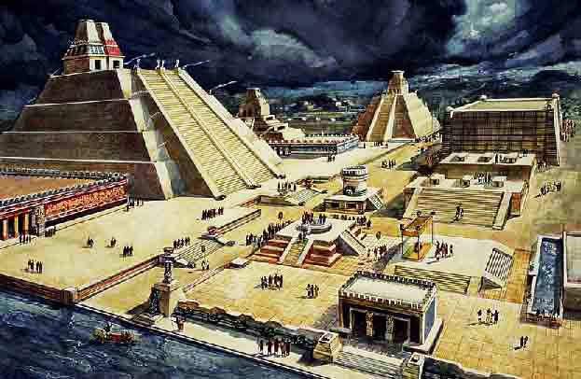
The Aztecs
Cities
Teotihuacan
Tenochtitlan

Slide 9
The Aztecs
Lang/Writing
Pictographs or glyphs
Not a complete writing system that can communicate all things

Slide 10
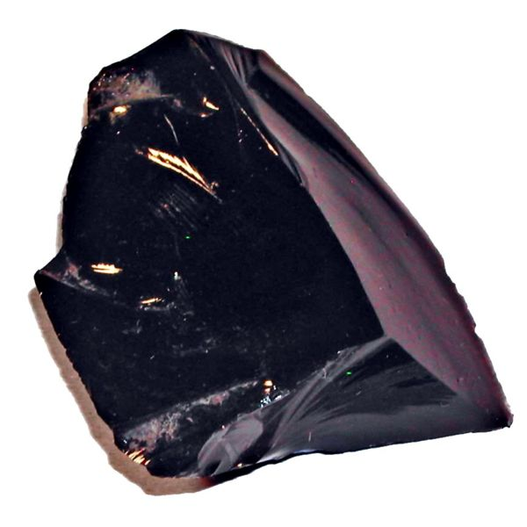
The Aztecs
Economy
Demanded tribute from those they conquered
Traded Obsidian

Slide 11
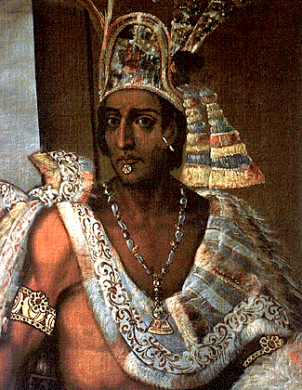
The Aztecs
Gov’t
Created Triple Alliance with:
Texcoco
Tlacopan
Emperor at the top – absolute power
Power weakens under Montezuma

Slide 12
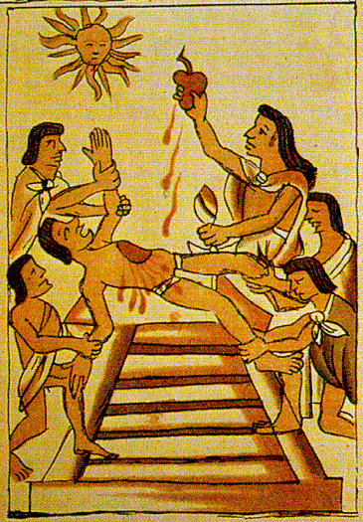
The Aztecs
Religion
Polythestic – over 1,000 gods
Offerings to the gods:
Dramas
Songs
Dances
Sacrifice to the Sun God- cut out human hearts

Slide 13
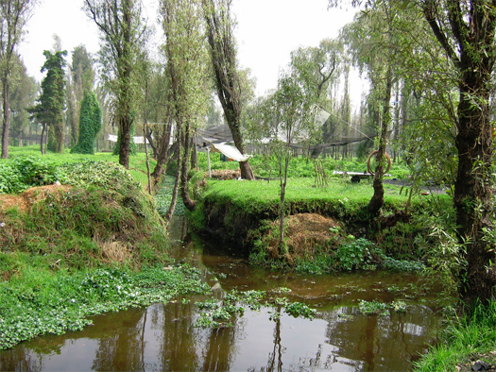
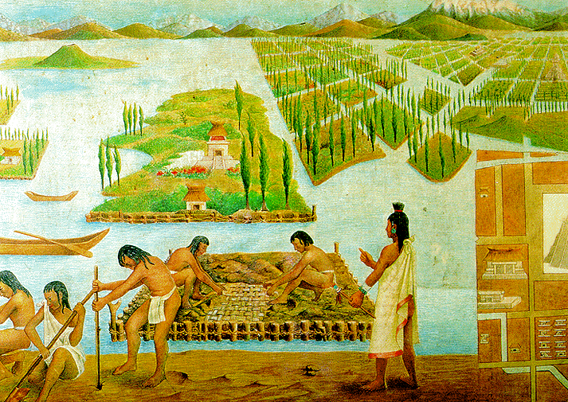
The Aztecs
Achievements
2 main calendars
Planned city of Tenochtitlan
Causeways or bridges to city
Chinampas: floating gardens

Slide 14
Decline of the Aztecs
Spanish conquistadors led by Hernando Cortes fought the Aztecs
Aztec leader Moctezuma II was killed (not sure if by Spanish or his own people)
Spanish killed thousands
Mexico speaks Spanish today because of this
Modern day Mexico city was built right on top of Tenochtitlan

Slide 15
Constructive Response Question
Who were the Aztecs and what did they do?

