Slide 1
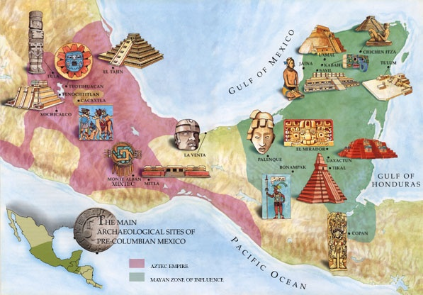
Mesoamerica
Outcome: The Earliest Americans

Slide 2
The Earliest Americans
The Earliest Americans
North and South America
Stretches unbroken 9,000 miles
Originally connected to Asia by a land bridge called Beringia
Most inhabitants (or ancestors) migrated this way
Others traveled by boat

Slide 3
Beringia

Slide 4
The Earliest Americans
Peopling of America
Started arriving after the Ice Age (1.9 million – 10,000 B.C.)
Ice Age lowered sea levels (hence Beringia) and allowed wild herds from Siberia to migrate to the Americas
People followed the herds and became first Americans (hunters and gatherers)

Slide 5
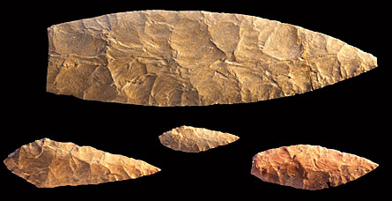
The Earliest Americans
Peopling of America (continued…)
Some say earliest humans found in North or South America date back to 40,000 B.C. or 10,000 B.C.
Evidence? Spearheads found in New Mexico date back to 9,500 B.C.
12,000-10,000 years ago the Ice Age ended- Ice melted and Beringia was swallowed
Agriculture began about 7,000 B.C.
With agriculture came permanent settlements

Slide 6
What is Mesoamerica?

Slide 7
The Olmec People

Slide 8
The Earliest Americans
Mesoamerica
Olmec
Located in the jungles of S. Mexico around 1200 B.C.
Often called Mesoamerica’s “mother culture”
Large head discovered in 1860 (p.244)
Built columns, altars, & colossal sculpted heads
Olmec thrived from 800-400 B.C.
Believed to have worshipped variety of nature gods including the jaguar spirit
Collapse: Unknown. Possibilities include decline by outside rulers or possibly that the Olmec began destruction of their monuments when their leaders died

Slide 9
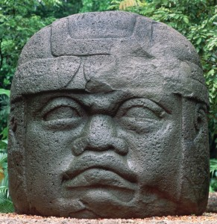
Olmec Head

Slide 10
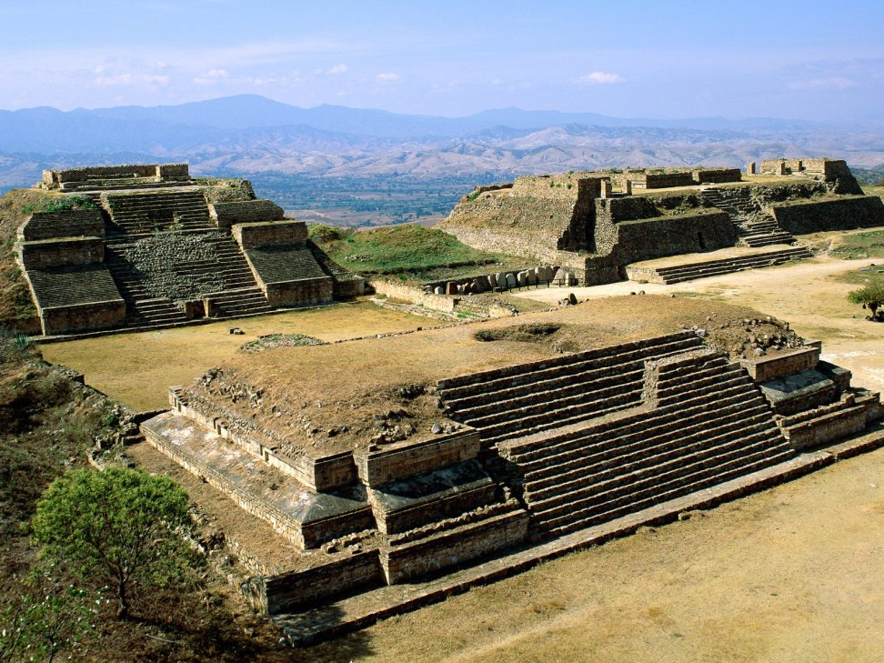
The Zapotec

Slide 11
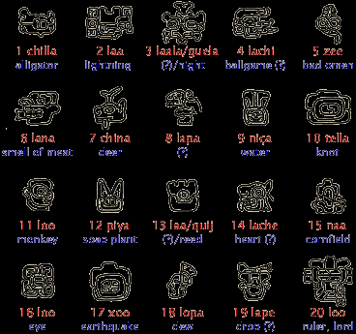
The Earliest Americans
Zapotec
Developed around time of declining Olmec in Oaxaca Valley
Oaxaca Valley has fertile soil, mild climate, and enough rainfall to support agriculture
By 500 B.C. they had created early forms of writing and a calendar system

Slide 12
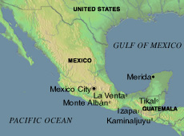
The Earliest Americans
First real urban center in Mesoamerica: Monte Alban, which at its peak had 25,000 people
Paved stones
Towering Pyramids, temples, palaces
Decline of Zapotec is also a mystery

Slide 13
Monte Alban

Slide 14
The Earliest Americans
Olmec and Zapotec Legacy
Influence powerful Maya
Olmec left notions of planned ceremonial centers & some glyph writing
Zapotec leave hieroglyphics & calendar system
Zapotec are America’s first city builders

Slide 15
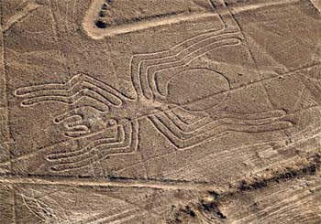
The Earliest Americans
Other
Moche, Nazca, and Chavin build centers in South America
Nazca lines (p.248)

Slide 16
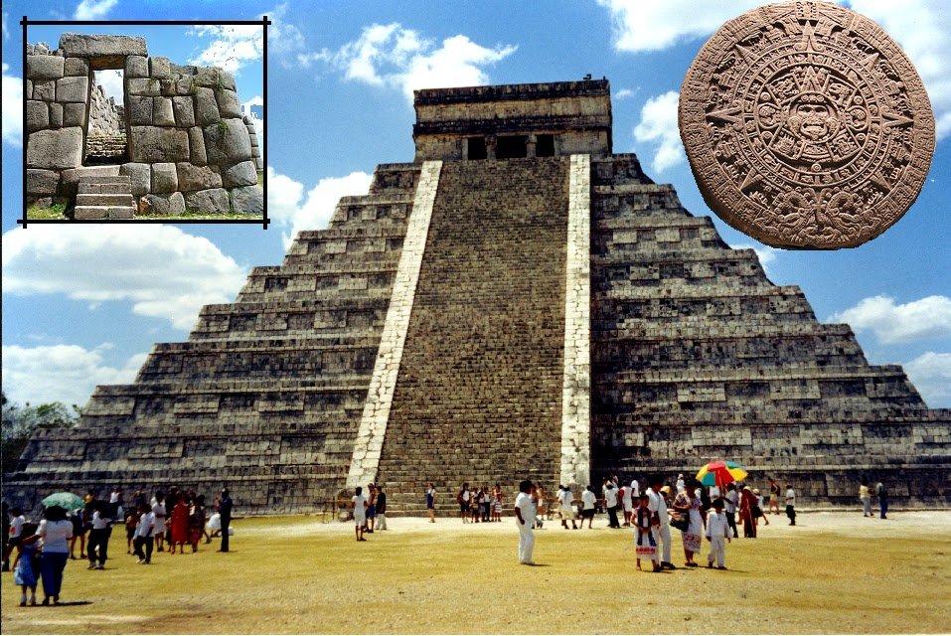
The Earliest Americans
Result: The Earliest Americans left a lasting legacy on North and South America that would eventually influence two of Mesoamerica’s greatest cultures: The Mayas and the Aztecs.

