Slide 1
US Bill of Rights (1791)

Slide 2
Canadians take over our country. They say that you may only keep 5 of your rights if you are to coexist with them peacefully. Which ones would you keep? Why?

Slide 3
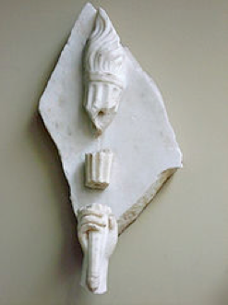
Liberties and Rights
1. Civil Liberties
1. Limitations on gov’t power
2. Civil Rights
1. Responsibilities of gov’t to protect individuals

Slide 4
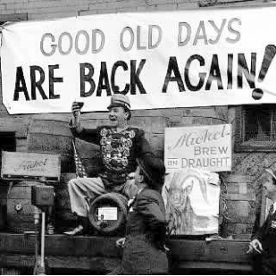
Types of Amendments
To amend means to alter, to change, to enhance or to abolish.
Alter- modifying to make somewhat different (17th- direct election of Senators)
Change- make fundamentally different (22nd- two-term limit on Presidency)
Insert- add something (19th- women can vote)
Abolish- get rid of something (13th-slavery)
The 21st Amendment
made it legal to sell
alcohol again

Slide 5
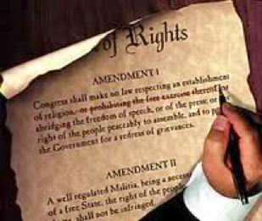
What is a Bill of Rights?
1. A statement of fundamental freedoms, rights and privileges for U.S. citizens
Limits the power of the Federal Gov’t
2. First 10 Amendments

Slide 6
What if…
A U.S. citizen has become angry with the government. He has planted a nuclear bomb in NYC that will explode in less than one hour. The police have him in custody, but he refuses to talk. There is not enough time to evacuate the city, and approximately 5 million people will die if he does not reveal the bombs location.
Is it ok to torture him?

Slide 7
First Amendment

Slide 8
First Amendment
“Congress shall make no law respecting an establishment of religion, or prohibiting the free exercise thereof; or abridging the freedom of speech, or of the press; or the right of the people peaceably to assemble, and to petition the Government for a redress of grievances.”

Slide 9
Freedom of Religion
Establishment Clause- Gov’t cannot promote a religion
Free Exercise Clause- Gov’t cannot prevent the practice of religion
The Lemon Test- determines when a law has the effect of establishing religion. Law must be…
Secular in its intent
Neutral in application (no favoritism)
Avoids excessive gov’t entanglement
“Congress shall make no law respecting an establishment of religion, or prohibiting the free exercise thereof”

Slide 10
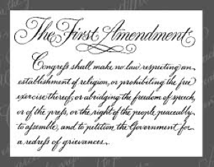
Freedom of Speech
Restrictions
Speech may be limited if it causes clear and present danger to public safety or national security
Schenck v. United States
Gov't may restrict speech that can cause immediate physical injury to others (Example: yelling "fire in a crowded theater would cause panic)
Slander- making false, damaging spoken statements about someone.
Libel- anything written that damages a person's reputation using false facts

Slide 11
Freedom of Speech
Restrictions
Obscenity – lacks social, educational, artistic value.
Time, Place, Manner – certain locations, times, and manners are considered inappropriate.

Slide 12
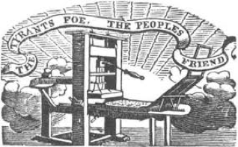
Freedom of the Press
1. Prior Restraint- The gov’t cannot prevent material from being published (censorship)
2. Restrictions

Slide 13
A Word About Defamation
1. Defamation is a false statement that hurts someone's reputation.
1. Includes libel and slander
2. To prove defamation, the statement must meet the following criteria:
1. Published
2. False
3. Injurious
3. Public figures must prove "actual malice" as well
1. Actual Malice- knew it was false

Slide 14
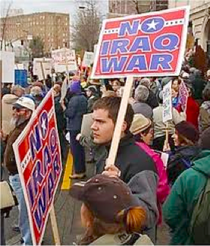
Freedom of Assembly
1. You have the right to gather and protest the gov’t
2. Restrictions
1. Gov’t can regulate time and place (rush hour, etc)

Slide 15
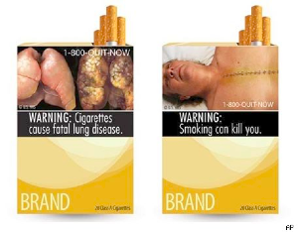
Freedom to Petition
1. Citizens (and states) may sue the gov’t
*FDA-enforced warning
labels on cigarettes, over
which the tobacco companies
sued the federal gov’t.

Slide 16
The 2nd and 3rd Amendments

Slide 17
Which of these should private citizens not be allowed to own, if any?
Handguns Automatic Shotguns
Grenades F-16 Fighter Jets
“Sawed-off” shotguns
Tanks
“Automatic” or “assault” rifles
High-Capacity magazines (50 round in one clip)
Grenade Launchers

Slide 18
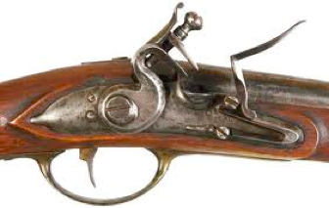
The 2nd Amendment
“A well regulated militia being necessary to the security of a free State, the right of the People to keep and bear arms shall not be infringed.”

Slide 19
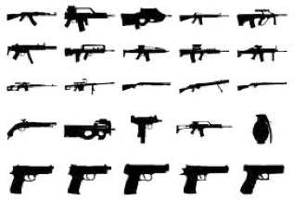
Why?
Included in the Bill of Rights for several purposes:
Protect the colonies from outside invasion
Arm the citizens for a number of reasons
Most controversially, to enable citizens to resist a tyrannical government

Slide 20
What Does it Mean?
Many disagree on the meaning of the 2nd Amendment
Most debate revolves around 3 words:
Militia- does this mean…
An official state army?
A loose collection of “citizen-soldiers”?
People- does this mean…
Every individual?
Only qualified individuals?
The state gov’ts?
Arms- does this mean…
All types of weapons?
Only “reasonable” weapons?
“A well regulated militia being necessary to the security of a free State, the right of the People to keep and bear arms shall not be infringed.”

Slide 21
District of Columbia v. Heller (2008)
A landmark case, in which the Supreme Court of the United States held that the 2nd Amendment protects an individual's right to possess a firearm for traditionally lawful purposes, such as self-defense within the home.
It was the first Supreme Court case in United States history to decide whether the Second Amendment protects an individual right to keep and bear arms for self defense.

Slide 22
3rd Amendment
“No soldier shall, in time of peace be quartered in any house, without the consent of the owner, nor in time of war, but in a manner to be prescribed by law.”

Slide 23
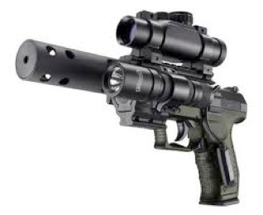
Assignment
Question: Is Gun Ownership Helpful or Hurtful to Society?
Read the two different opinions about gun control
Write 5-10 sentences explaining your point of view on the issue of guns and gun control.
Use at least 3 facts from the reading to make your point
Class debate!!

Slide 24
Rights of the Accused Part 1
Amendments 4-5

Slide 25
The Miranda Case
In March of 1963, Ernesto Miranda was arrested for robbery in Flagstaff, Arizona. While in custody, he confessed to kidnapping and raping an 18-year-old woman ten days earlier. He signed a confession that included the statement “I do hereby swear that I make this statement…with full knowledge of my legal rights…” However, at no time was Miranda informed of his right to remain silent, or of his right to a lawyer.
In court, his lawyer argued that he had not known his rights and the signed statement was not accurate, but Miranda was sentenced to up to 60 years in prison.
Q’s:
1. Had Miranda been deprived of his rights as a result of
ignorance?
2. Is it the responsibility of the police to educate you about
your rights?

Slide 26
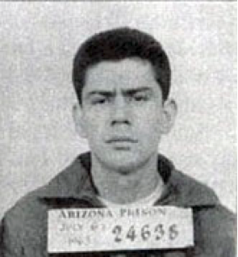
Miranda Rights
“You have the right to
remain silent. Anything you say or do can and will be held against you in a court of law.
You have the right to an attorney. If you cannot afford an attorney, one will be provided for you. Do you understand these rights I
have just read to you?”
Miranda’s conviction was
overturned by the Supreme Court because
The police had failed to inform him of his rights!

Slide 27
The 4th Amendment says…
“The right of the people to be secure in their persons, houses, papers, and effects, against unreasonable searches and seizures, shall not be violated, and no warrants shall issue, but upon probable cause, supported by oath or affirmation, and particularly describing the place to be searched, and the persons or things to be seized.”

Slide 28
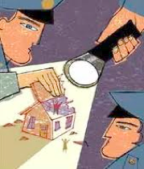
4th Amendment
No unreasonable searches or seizures
1. Must have a search warrant to conduct a search of a person or location to find evidence of a crime and to confiscate evidence if found
Exclusionary Rule- evidence obtained w/out a warrant cannot be used in court
2. Must have probable cause
Probable Cause- above and beyond belief that someone has committed a crime (applies only to police)
Reasonable Suspicion- less than probable cause, applicable in public places (not police)

Slide 29
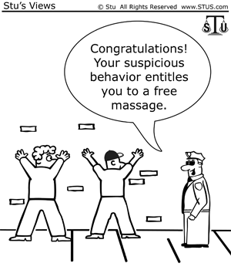
When Do You Need a Warrant?
When the 4th Amendment says “persons”, does that include:
a person’s clothes? Yes
a person’s wallet? Yes
a person’s blood or bodily fluid? Maybe.
a person’s hair? Maybe. If the hair is on the ground, then it is subject to confiscation.
When the 4th Amendment says “houses”, does that include:
an apartment? Yes
your front porch? Yes
a mobile home? Maybe. Depends on whether it is being used as a home or a car.
a room you are renting from a friend? Maybe. If the person who owns the home allows the search it may be allowed.
When the 4th Amendment says “papers”, does that include:
a diary? Yes
a book in your house? Yes
your email? Probably not.
your text messages? Probably not.
When the 4th Amendment says “effects”, does that include:
your backpack? Yes
your locker? Yes
your iPod? Yes
your collection of comics? Yes

Slide 30
The 5th Amendment says…
“No person shall be held to answer for a capital, or otherwise infamous crime, unless on a presentment or indictment of a Grand Jury, except in cases arising in the land or naval forces, or in the Militia, when in actual service in time of War or public danger; nor shall any person be subject for the same offence to be twice put in jeopardy of life or limb; nor shall be compelled in any criminal case to be a witness against himself, nor be deprived of life, liberty, or property, without due process of law; nor shall private property be taken for public use, without just compensation.”

Slide 31
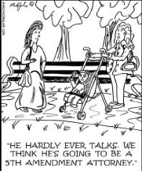
5th Amendment
Criminal Charges- Those charged with a crime…
Right to a Grand Jury
Decides if there is enough evidence to proceed with charges
Double Jeopardy
You cannot be charged with the same crime twice
Right to avoid Self-Incrimination
You do not have to testify if you might incriminate yourself “pleading the fifth"
2. Eminent Domain
Gov’t may take private property for public use, but the owner must be paid market value
Protects private property rights

Slide 32
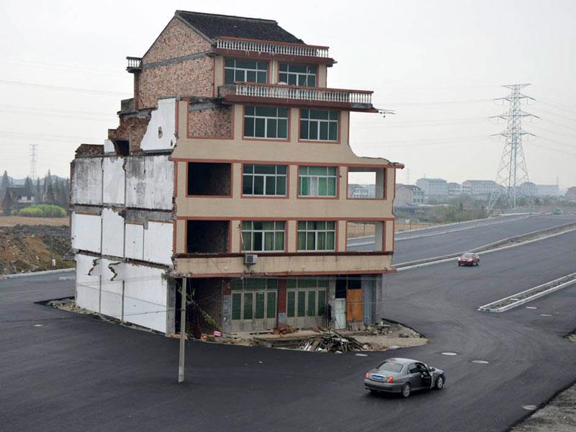
No Eminent Domain in China? This Chinese man refused to sell his house to the Chinese gov't so they could build a freeway, so they built the freeway around it!

Slide 33
Activity: P.V. Mall v. Wendy
1. Read "The Fourth Amendment Goes to the Mall".
2. On your own paper, create at least 3 reasons to argue each of the following:
a. Wendy is guilty of a crime
b. Wendy's 4th Amendment rights
were violated
3. Which do you think it is? Explain your
reasoning.

Slide 34
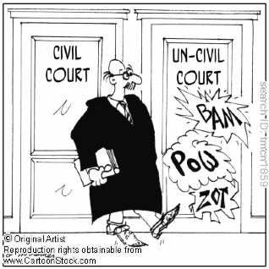
TERMS
1. Civil- failure to carry out legal duty
A. Ex: breaking a contract
2. Criminal- danger to society
A. Ex: murder
3. Prosecution- the gov’t attorney charging and trying the case against a person accused of a crime
4. Defense- the person accused of a crime

Slide 35
The 6th Amendment says…
“In all criminal prosecutions, the accused shall enjoy the right to a speedy and public trial, by an impartial jury of the State and district wherein the crime shall have been committed, which district shall have been previously ascertained by law, and to be informed of the nature and cause of the accusation; to be confronted with the witnesses against him; to have compulsory process for obtaining witnesses in his favor, and to have the Assistance of Counsel for his defense.”

Slide 36
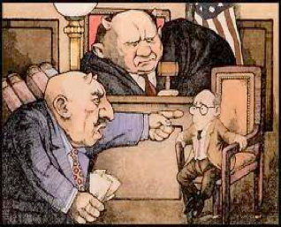
6th Amendment- Criminal Trials
In a criminal trial, the accused has the right to…
A speedy, public trial
A. To prevent long-term incarceration w/out a trial
An unbiased jury
A. Must have 100% (12/12) to convict in criminal trials
3. Notice of accusation
A. The accused must be informed about what he/she is charged w/

Slide 37
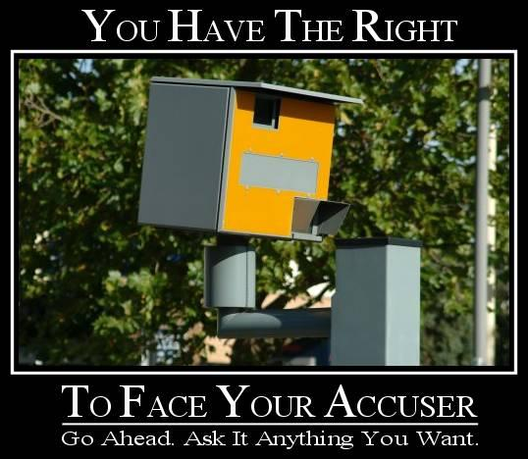
6th con’t
4. Confrontation
A. The defense may confront (question) witnesses
5. Compulsory Process
A. The defense may call witnesses in its favor
6. Counsel (a lawyer)

Slide 38
The 7th Amendment says…
“In Suits at common law, where the value in controversy shall exceed twenty dollars ($5,000 today), the right of trial by jury shall be preserved, and no fact tried by a jury, shall be otherwise re-examined in any Court of the United States, than according to the rules of the common law.”

Slide 39
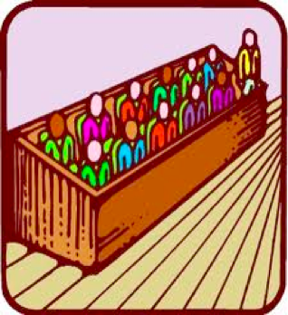
7th Amendment- Civil Trials
In a civil trial…
Non-Criminal
Right to sue people or businesses
Under $5,000 only a judge presides
Over $5,000 a jury presides
Simple majority (51%) needed to convict in civil trials
Punishment = fines or prison time (never death penalty)

Slide 40
Assignment: Punishment Scenarios
1. In your group, read the scenario on your desk.
2. Discuss together an appropriate punishment for the crime.
3. Once you have decided on a punishment as a group, each person must write in complete sentences:
-What punishment your group has agreed on
-Why that punishment is appropriate for that crime

Slide 41
The 8th Amendment says…
“Excessive bail shall not be required, nor excessive fines imposed, nor cruel and unusual punishments inflicted.”

Slide 42
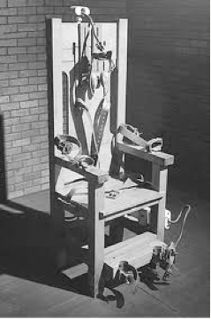
8th Amendment
No excessive bail
No excessive fines
No cruel and unusual punishment
No torture as a punishment
Some forms of capital punishment are unconstitutional
Capital Punishment= death penalty
“Let the punishment fit the crime”
Should the electric
Chair be considered
“cruel and unusual”?

Slide 43
Life Without Parole for Teens
At the age of 14, Evan Miller brutally beat his 52 year old neighbor with a baseball bat, stole $350, and set his mobile home on fire. His neighbor died from smoke inhalation. Evan was tried as an adult and sentenced to life in prison without parole.
Is this a fair punishment?

Slide 44
The 9th Amendment says…
“The enumeration in the Constitution of certain rights shall not be construed to deny or disparage others retained by the people.”

Slide 45
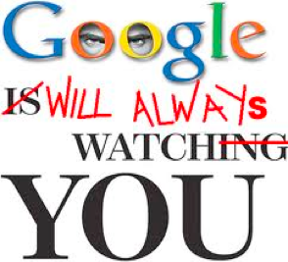
9th Amendment
The Founding Fathers knew that they couldn’t list all rights
This amendment is intended to protect rights not listed in the Constitution, ideas such as…
Innocent until proven guilty
The right to a fair trial
The right to vote
The right to travel
The right to privacy
Do we really have
privacy anymore?

Slide 47
The 10th Amendment says…
“The powers not delegated to the United States by the Constitution, nor prohibited by it to the States, are reserved to the States respectively, or to the people.”

Slide 48
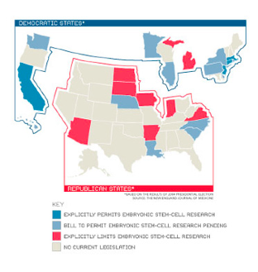
10th Amendment
Originally, the Bill of Rights only applied to federal laws
The 10th amendment says that anything that is not specifically the federal govt’s job, is left up to the states
Federalism- the balance of power between federal and state gov’ts
14th Amendment made the Bill of Rights applicable to both federal and state laws

Slide 49
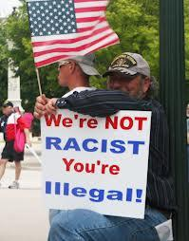
Arizona v. United States
Traditionally, immigration has been the Federal government's responsibility. However, in 2010, Arizona Governor Jan Brewer did not feel that the Federal Government was doing enough to address illegal immigration in Arizona. The Governor and Arizona's state congress created SB 1070, legislation which took Federal immigration laws and made them enforceable by the State of Arizona. SB 1070 made it a state misdemeanor crime for an immigrant to be in Arizona without carrying registration documents required by Federal law, authorized state and local law enforcement of federal immigration laws, and creacked down on those sheltering, hiring and transporting illegal immigrants.
Is this Constitutional? This is a 10th Amendment issue!

Slide 50
Arguments for Arizona:
1. Nearly half (47%) of illegal aliens enter the U.S. along the Arizona/Mexico border.
2. in 2009, the total education, medical, and incarceration costs in Arizona due to illegal immigration are $2.6 Billion a year.
3. The Arizona Department of Corrections estimates that 17% of it's prison population is illegal aliens, and 22% of felony defendants in Maricopa County are illegal aliens. The criminal records of over 55,000 illegal aliens nationwide revealed:
- An average of 8 arrests and 13 offenses each per individual.
- 45% were arrested for drug or immigration offenses; 15% for property-related offenses such as burglary, larceny-theft, moto vehicle theft, or property damage; 12% were for murder, robbery, assault, and sex-related crimes.
4. The escalating drug war in Mexico is spilling over the border. Federal agents seized over 1.2 million lbs of marijuana at the Arizona/Mexico border alone.
5. Between 2007 and 2009 there were 2,500 murders in Mexico near the Arizona border.
6. The lack of Federal action in regards to illegal immigration in Arizona leaves Arizona no choice but to act to protect its citizens.
Arguments for United States:
1. The "Support Our Law Enforcement and Safe Neighborhoods Act (S.B. 1070) promotes racial profiling, leading to police officers pulling over more people who appear to be of Latin American descent.
2. The law interferes with out Civil Rights, and gives the state of Arizona too much power.
3. Illegal immigrants are simply looking for a better life, and are an important part of the Arizona economy and workforce.
4. A state does not have the authority to address immigration, which is Constitutionally a Federal responsibility. THe federal government claims that the law is unconstitutional, on the theory that Arizona was trying to move in on the federal government's superior power to enforce federal immigration laws.
*On the back of your paper, answer the following questions:
1. Which side do you agree with more? Why? Give examples. (2-3 sentences)
2. In your opinion, who should be in control of immigration, the Federal gov't or the states?

Slide 51
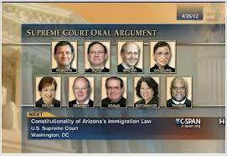
Result of the Case
In June 2012, the U.S. Supreme Court ruled on the case, Arizona v. United States, upholding the provision requiring immigration status checks during law enforcement stops, but striking down three other provisions as violations of the Supremacy Clause (Art. 6, Section 1.2 establishes the U.S. Constitution, federal statutes, and U.S. Treaties as "the supreme law of the land.") of the United States Constitution.

Slide 52
Review

